Slide 1
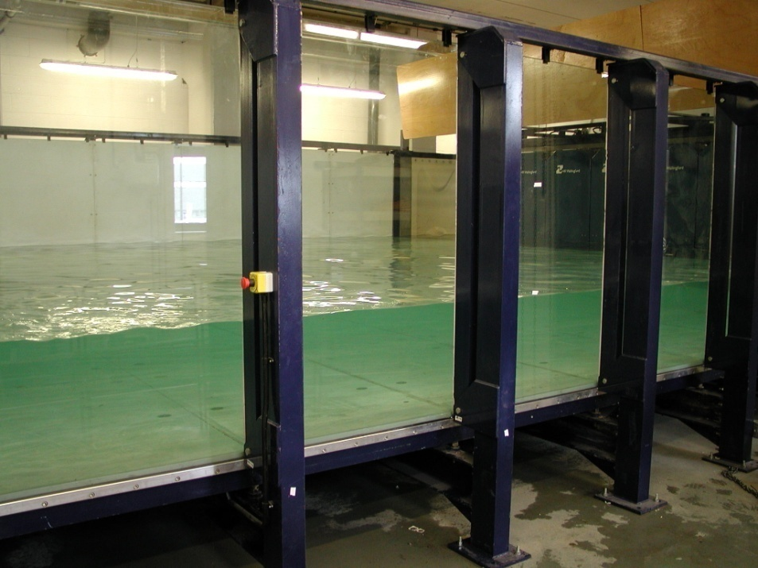
Nonstationary regimes in gravity wave turbulence
S Lukaschuk¹ , R Bedard¹, S Nazarenko²
¹ Fluid Dynamics Laboratory, University of Hull
² Mathematics Institute, University of Warwick

Slide 2
Experiment
8-panel Wave Generator
C₂
CCD
M
C₁
Laser
Horizontal size: 8 x 12 m, water depth: up to 1 m

Slide 3
Wave generation

Slide 4
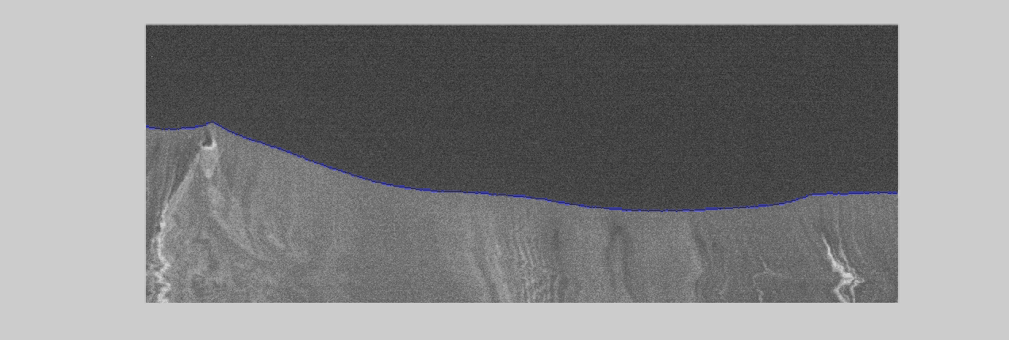
Real-time cross sectional view

Slide 5


Theoretical predictions for spectra of stationary surface gravity waves
Weak turbulence theory (Zakharov, 1966 )
Breaking waves (Phillips ,1958)
sharp wave crests
strong nonlinearity
2K. Breaking waves (Kuznetsov , 2004)
slope breaks occurs in 1D lines
wave crests are propagating with a preserved shape
Finite size effects (Zakharov 2005; Nazarenko et al 2006)

Slide 6
1D k- and ω-spectra

Slide 7
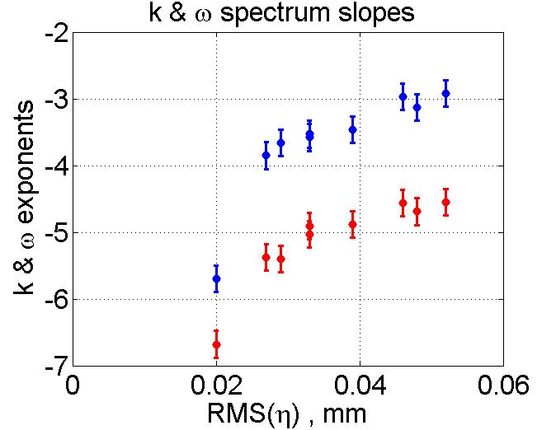
Set of experimental data
 | Wave Amplitude a.u. | Stationary Wave height RMS, cm | Coef. of Nonlinearity | k - Slope | ω - Slope
1 | 0.2 | 2.0 | 0.09 | -5.7 | -6.68
2 | 0.25 | 2.7 | 0.125 | -3.85 | -5.38
3 | 0.3 | 2.9 | 0.134 | -3.66 | -5.4
4 | 0.35 | 3.3 | 0.150 | -3.58 | -4.91
5 | 0.4 | 3.3 | 0.15 | -3.53 | -5.03
6 | 0.45 | 3.9 | 0.18 | -3.46 | -4.88
7 | 0.5 | 4.8 | 0.225 | -3.13 | -4.69
8 | 0.55 | 4.6 | 0.21 | -2.97 | -4.56
9 | 0.6 | 5.2 | 0.24 | -2.92 | -4.55
Images:
R
S
D
D
D
One-point measurements
0
30
60
100
t, min

Slide 8
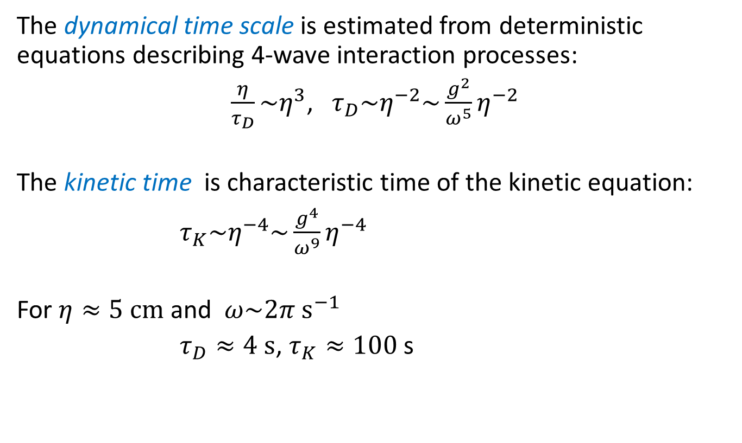
Rising waves: characteristic time estimates

Slide 9
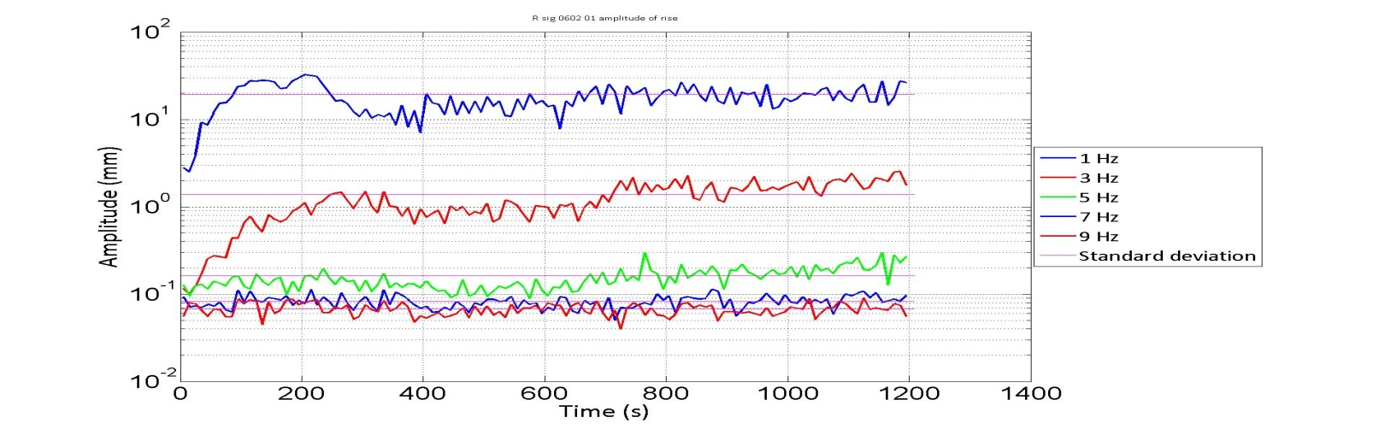
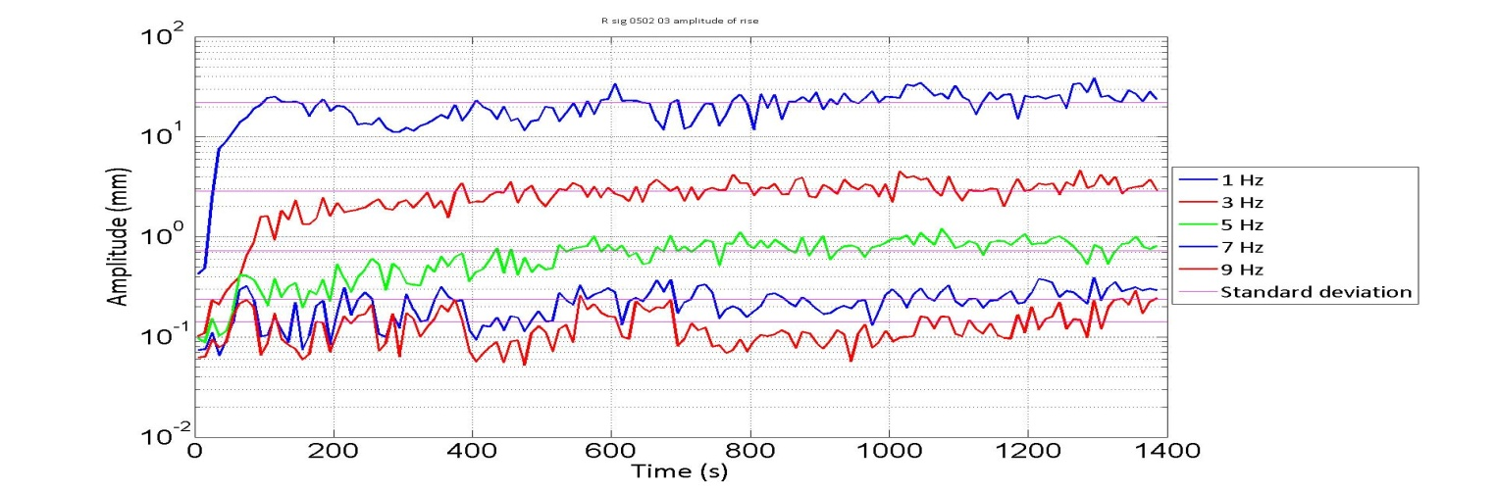
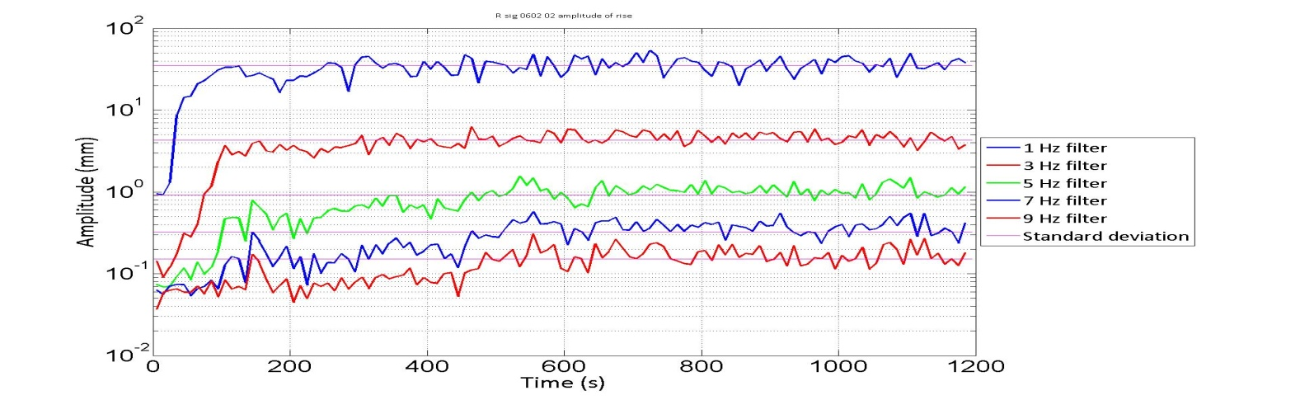
t-domain, rise filtered elevation
 | RMS cm | Nlin Coeff | k - Slope
1 | 2.0 | 0.09 | -5.7
2 | 2.7 | 0.125 | -3.85
3 | 2.9 | 0.134 | -3.66
4 | 3.3 | 0.150 | -3.58
5 | 3.3 | 0.15 | -3.53
6 | 3.9 | 0.18 | -3.46
7 | 4.8 | 0.225 | -3.13
8 | 4.6 | 0.21 | -2.97
9 | 5.2 | 0.24 | -2.92
Characteristic time

Slide 10
k-domain, Rise, small amplitudes
(frozen turbulence)
 | RMS cm | Nlin Coeff | k - Slope
1 | 2.0 | 0.09 | -5.7
2 | 2.7 | 0.125 | -3.85
3 | 2.9 | 0.134 | -3.66
4 | 3.3 | 0.150 | -3.58
5 | 3.3 | 0.15 | -3.53
6 | 3.9 | 0.18 | -3.46
7 | 4.8 | 0.225 | -3.13
8 | 4.6 | 0.21 | -2.97
9 | 5.2 | 0.24 | -2.92
F1: 5 m⁻¹
F2: 10 m⁻¹
F3: 80 m⁻¹
F4: 160 m⁻¹
F5: 320 m⁻¹

Slide 11
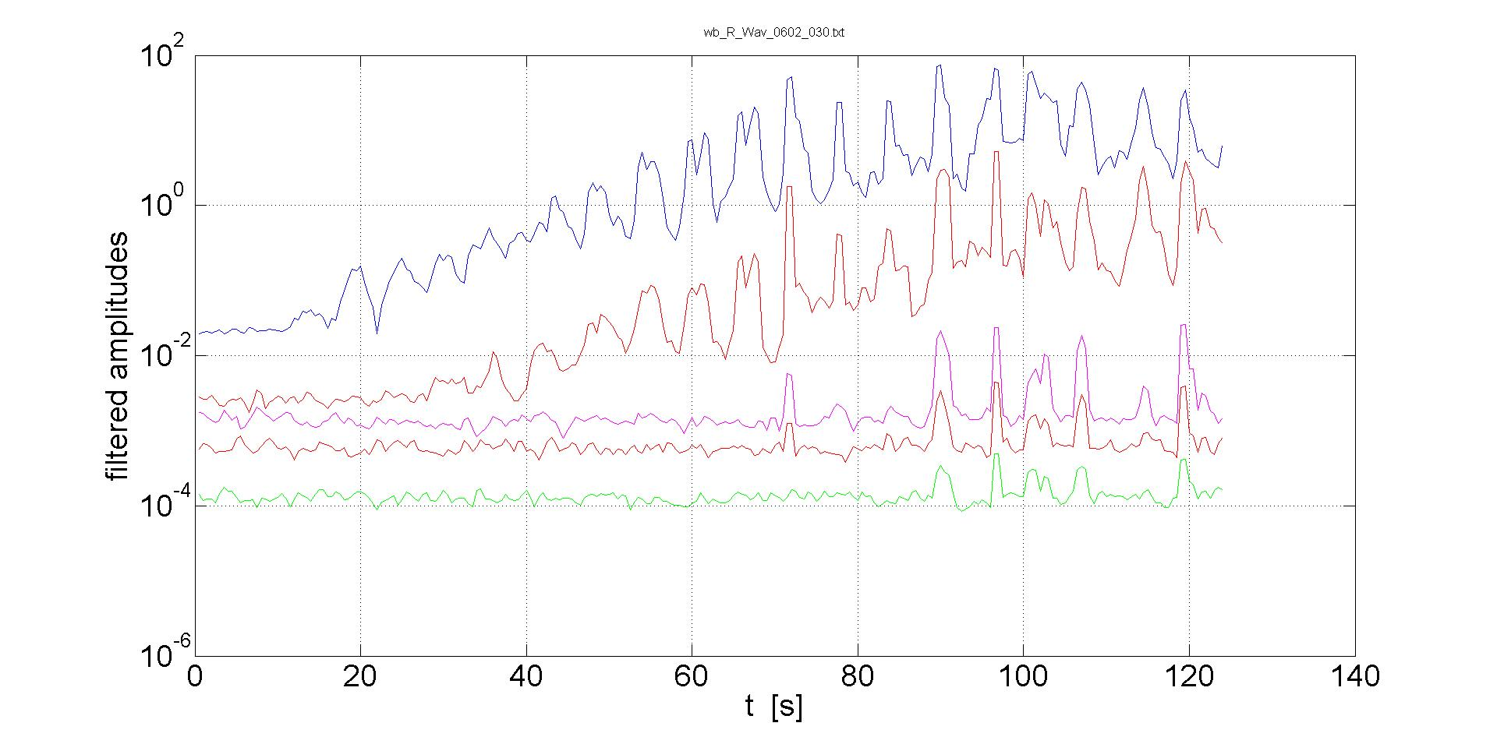
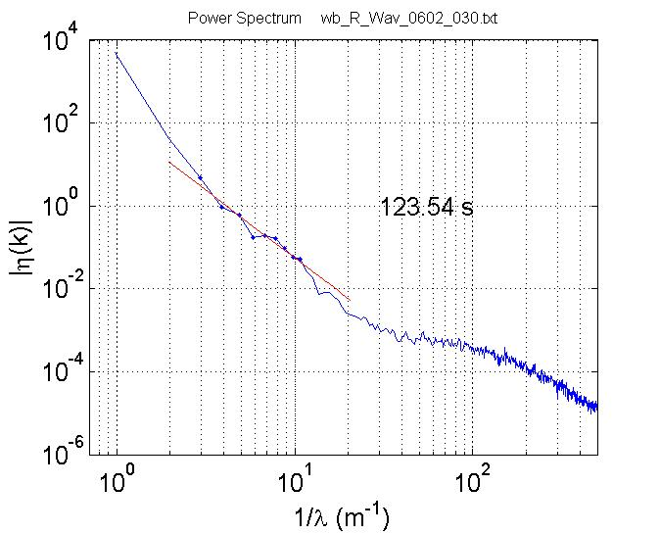
k-domain, Rise, medium amplitudes
 | RMS cm | Nlin Coeff | k - Slope
1 | 2.0 | 0.09 | -5.7
2 | 2.7 | 0.125 | -3.85
3 | 2.9 | 0.134 | -3.66
4 | 3.3 | 0.150 | -3.58
5 | 3.3 | 0.15 | -3.53
6 | 3.9 | 0.18 | -3.46
7 | 4.8 | 0.225 | -3.13
8 | 4.6 | 0.21 | -2.97
9 | 5.2 | 0.24 | -2.92
Breaking waves
Front
propagation
F1: 5 m⁻¹
F2: 10 m⁻¹
F3: 80 m⁻¹
F4: 160 m⁻¹
F5: 320 m⁻¹

Slide 12
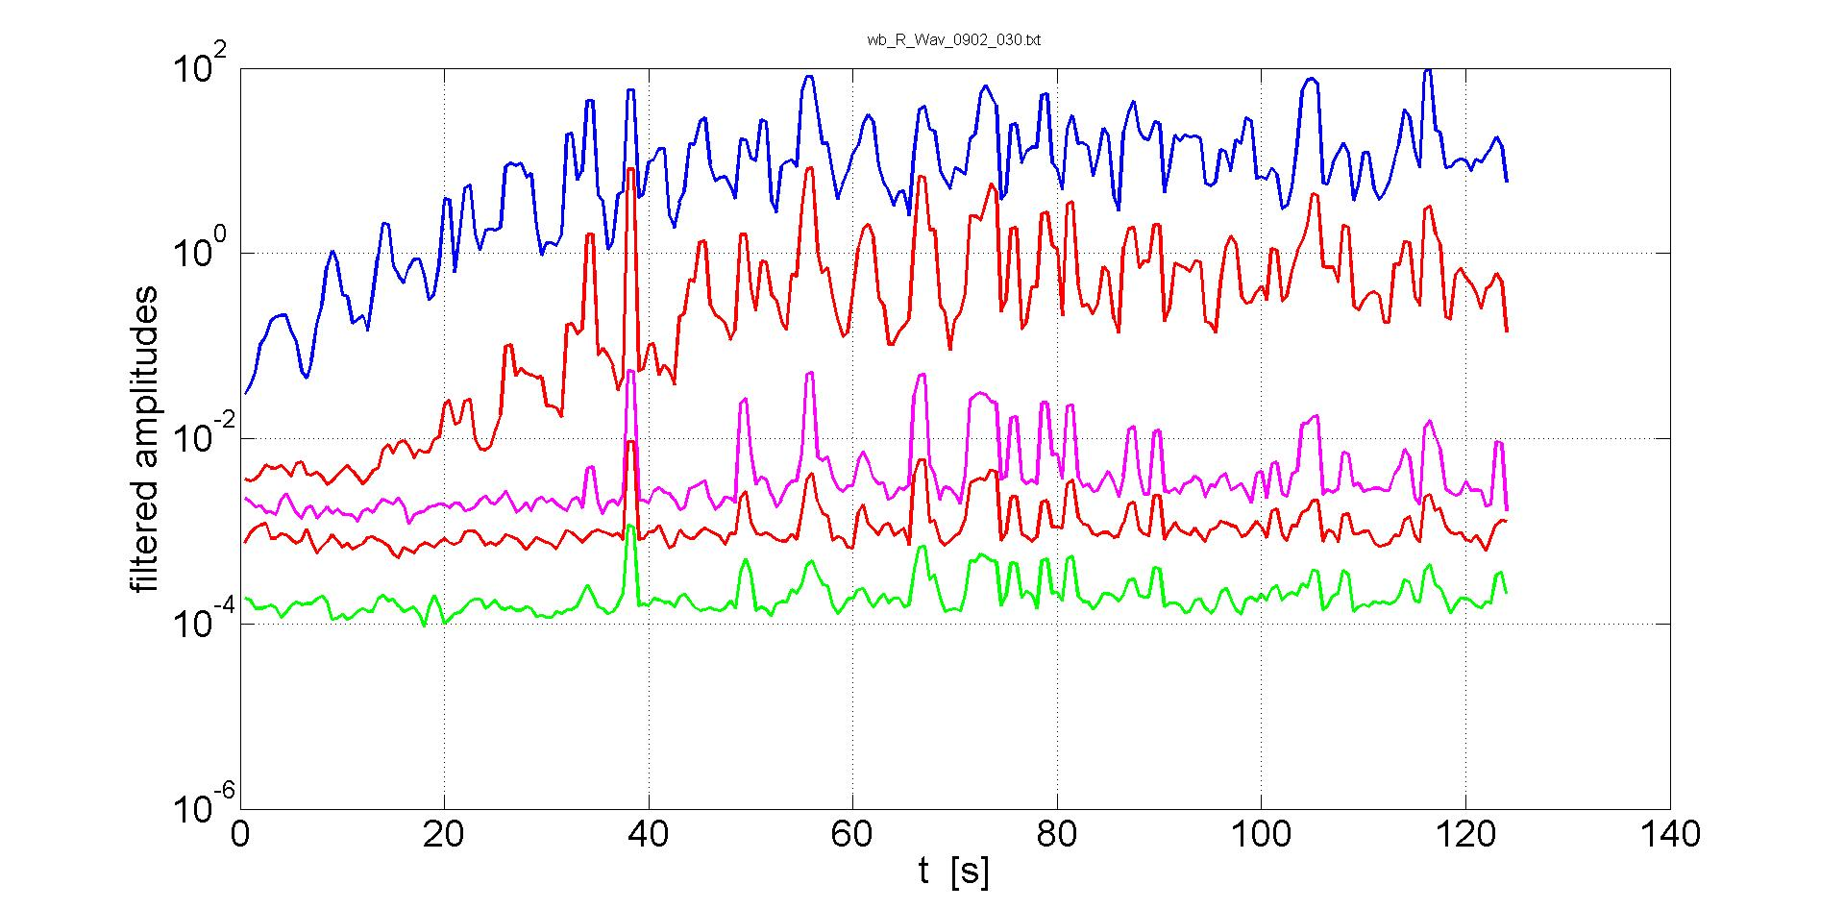
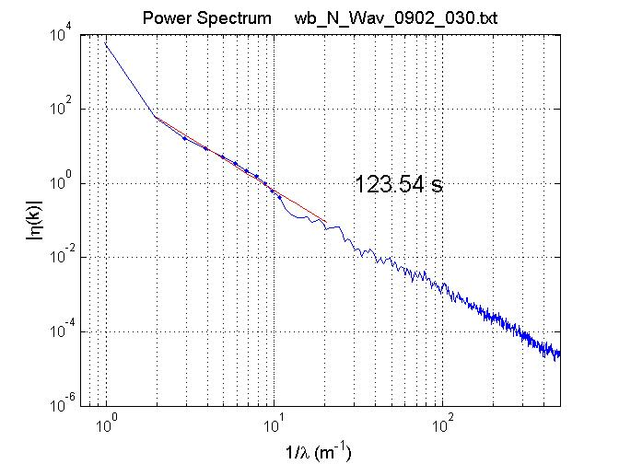
k-domain, Rise, high amplitudes
 | RMS cm | Nlin Coeff | k - Slope
1 | 2.0 | 0.09 | -5.7
2 | 2.7 | 0.125 | -3.85
3 | 2.9 | 0.134 | -3.66
4 | 3.3 | 0.150 | -3.58
5 | 3.3 | 0.15 | -3.53
6 | 3.9 | 0.18 | -3.46
7 | 4.8 | 0.225 | -3.13
8 | 4.6 | 0.21 | -2.97
9 | 5.2 | 0.24 | -2.92
F1: 5 m⁻¹
F2: 10 m⁻¹
F3: 80 m⁻¹
F4: 160 m⁻¹
F5: 320 m⁻¹

Slide 13
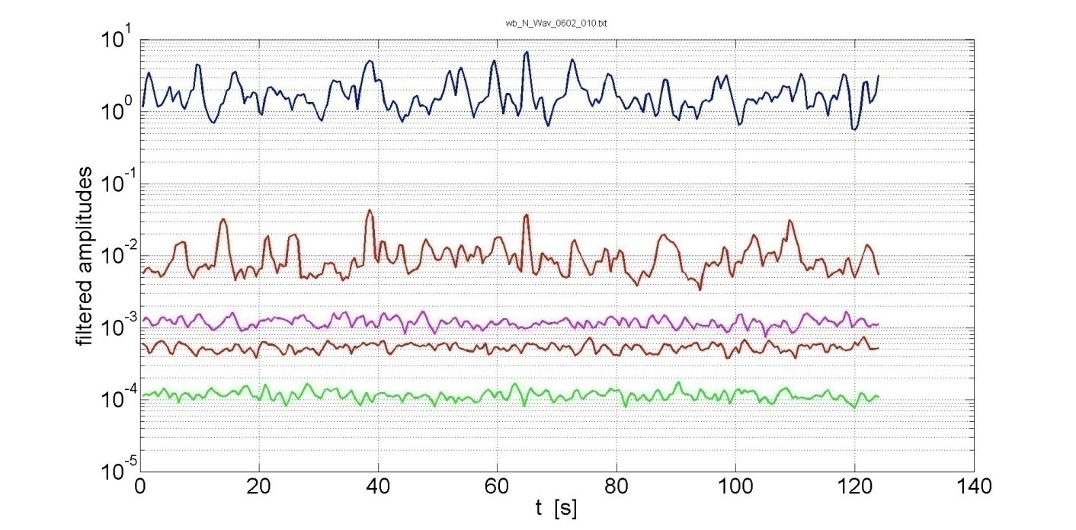
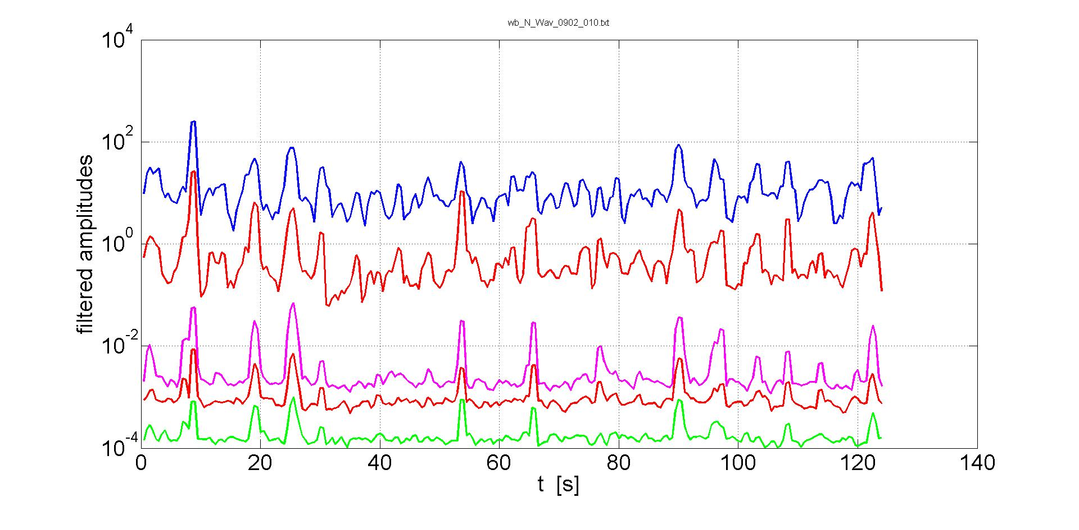
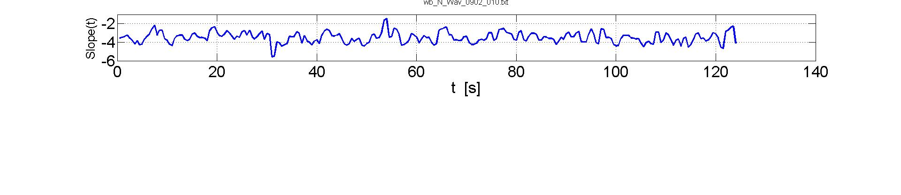
k-domain, Stationary, low & high amplitudes
 | RMS cm | Nlin Coeff | k - Slope
1 | 2.0 | 0.09 | -5.7
2 | 2.7 | 0.125 | -3.85
3 | 2.9 | 0.134 | -3.66
4 | 3.3 | 0.150 | -3.58
5 | 3.3 | 0.15 | -3.53
6 | 3.9 | 0.18 | -3.46
7 | 4.8 | 0.225 | -3.13
8 | 4.6 | 0.21 | -2.97
9 | 5.2 | 0.24 | -2.92
F1: 5 m⁻¹
F2: 10 m⁻¹
F3: 80 m⁻¹
F4: 160 m⁻¹
F5: 320 m⁻¹

Slide 14
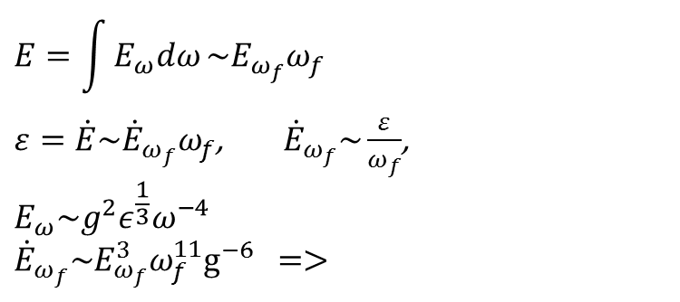

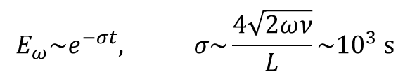

Decay characteristics estimates
WT decay:
Decay due to wall friction:
Crossover amplitude:

Slide 15
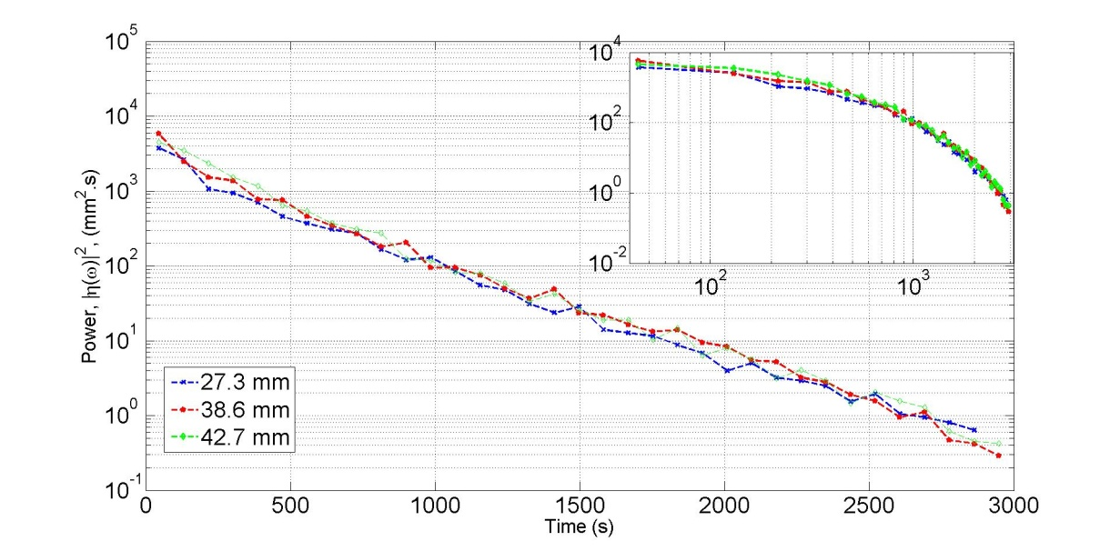
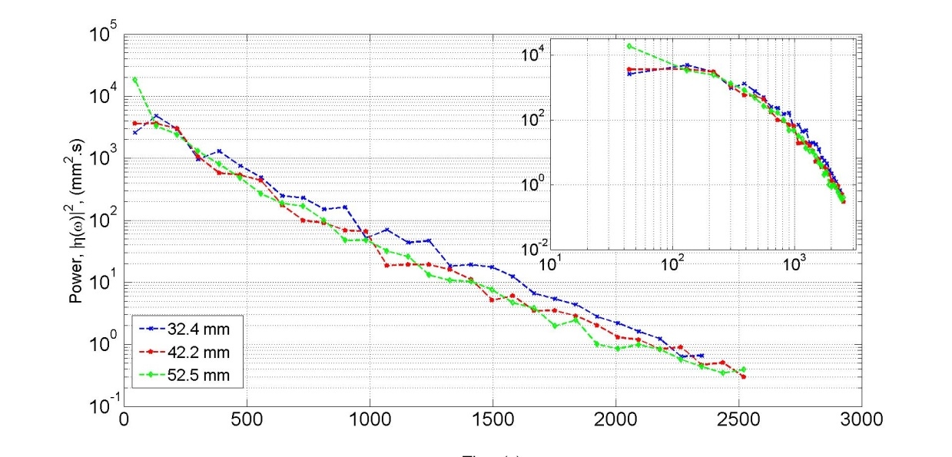
ω-domain, decay of the main peak (~1 Hz) back wall 0 and 30 deg
 | RMS cm | Nlin Coeff | k - Slope
1 | 2.0 | 0.09 | -5.7
2 | 2.7 | 0.125 | -3.85
3 | 2.9 | 0.134 | -3.66
4 | 3.3 | 0.150 | -3.58
5 | 3.3 | 0.15 | -3.53
6 | 3.9 | 0.18 | -3.46
7 | 4.8 | 0.225 | -3.13
8 | 4.6 | 0.21 | -2.97
9 | 5.2 | 0.24 | -2.92

Slide 16
t-domain, decay elevation RMS (t)
 | RMS cm | Nlin Coeff | k - Slope
1 | 2.0 | 0.09 | -5.7
2 | 2.7 | 0.125 | -3.85
3 | 2.9 | 0.134 | -3.66
4 | 3.3 | 0.150 | -3.58
5 | 3.3 | 0.15 | -3.53
6 | 3.9 | 0.18 | -3.46
7 | 4.8 | 0.225 | -3.13
8 | 4.6 | 0.21 | -2.97
9 | 5.2 | 0.24 | -2.92
Filter 4-7Hz

Slide 17
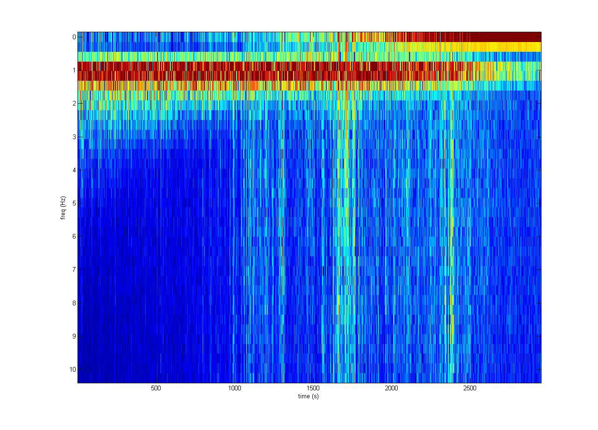
Time dependence of the ω-spectrum for weak nonlinearity
 | RMS cm | Nlin Coeff | k - Slope
1 | 2.0 | 0.09 | -5.7
2 | 2.7 | 0.125 | -3.85
3 | 2.9 | 0.134 | -3.66
4 | 3.3 | 0.150 | -3.58
5 | 3.3 | 0.15 | -3.53
6 | 3.9 | 0.18 | -3.46
7 | 4.8 | 0.225 | -3.13
8 | 4.6 | 0.21 | -2.97
9 | 5.2 | 0.24 | -2.92

Slide 18
Conclusions
At the developing stage our experiment shows front propagation of turbulent energy along the k-spectra towards high k. In addition to this we observed a instantaneous injection of spectral energy into high k’s due to breaking events
At the late decay stage wave turbulent energy decreases exponentially in our case of an essentially small size flume, which due to significant contribution of wall friction
Finite size effects are responsible for non-monotonic decay of the wave spectrum tail. This effect is much more strong for “underdeveloped” turbulent regimes and not such significant for the case were initial state is characterized by a wide spectrum
Wave turbulence comprises a mixture of smooth chaotic waves and breaks which interact and influence each other
This influence were observed in our experiment as propagation of spectral humps down and up along the k-spectrum,

Slide 20
