Slide 1
Investigations of seismic emission and shut-in pressure behavior during micro-hydraulic fracturing of plexiglass
Institute of Mining SB RAS
Novosibirsk, Russia
Patutin A.V., Rybalkin L.A., Serdyukov S.V.
Novosibirsk
2019

Slide 2
Outline
Purpose and objectives of the study
Laboratory setup for hydraulic fracturing
Test results for longitudinal and transverse fracturing: working fluid pressure and seismic emission
Two models of the crack oscillation with fluid flow and modeling results
Shut-in pressure determination by Hydraulic Fracturing Stress Measurements (HFSM)
Interpretation errors caused by borehole tool size

Slide 3
purpose and objectives of the study
Purpose:
Investigation of physical processes during hydraulic fracturing
Assessment of possibilities for determining the properties of the medium and parameters of a crack using the information derived
Objectives:
Investigation of seismic emission generated by hydraulic fracturing
Study of shut-in pressure behavior
Features of the Experiment:
Plexiglass block medium without external load
Working fluid – low viscosity oil
The hydraulic system has high stiffness; fractures do not reach the surface of the blocks
Two types of fractures: in the plane of the hole (longitudinal) or across the hole axis (transverse)

Slide 4
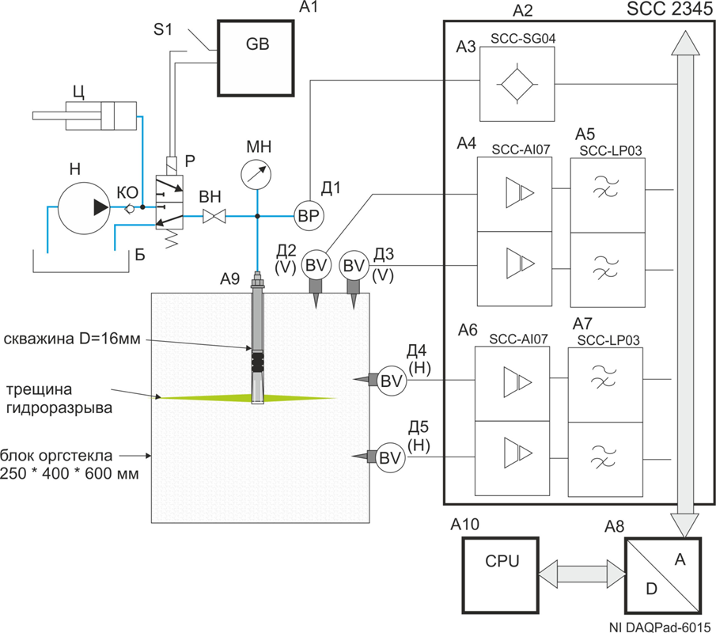
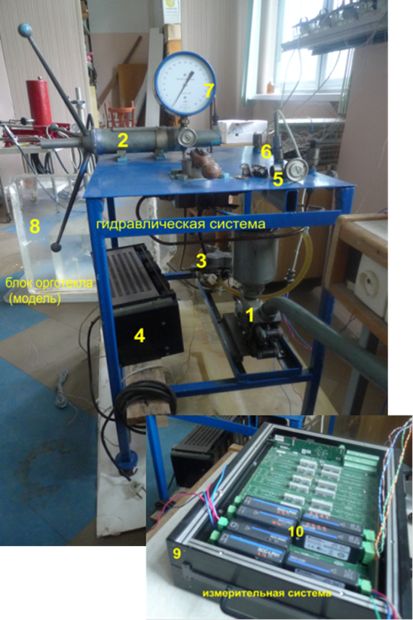
Laboratory setup
CVP
hydraulic system
plexiglass
hole D=16 mm
hydraulic fracture
plexiglass block
250x400x600 mm
measuring system
1(Н) – pump; 2(CVP) – controlled volume pump; 3(Р) – hydraulic distributor; 4(GB) – power-supply unit; 5(ВН) – globe valve; 6(BP) – pressure sensor; 7(МН) – reference pressure gauge; 8 – plexiglass block; 9(А2) – SC-2345 Carrier (NI); 10 – measuring modules; BV – seismic sensors (geophones GMT-12.5) with vertical and horizontal installation

Slide 5
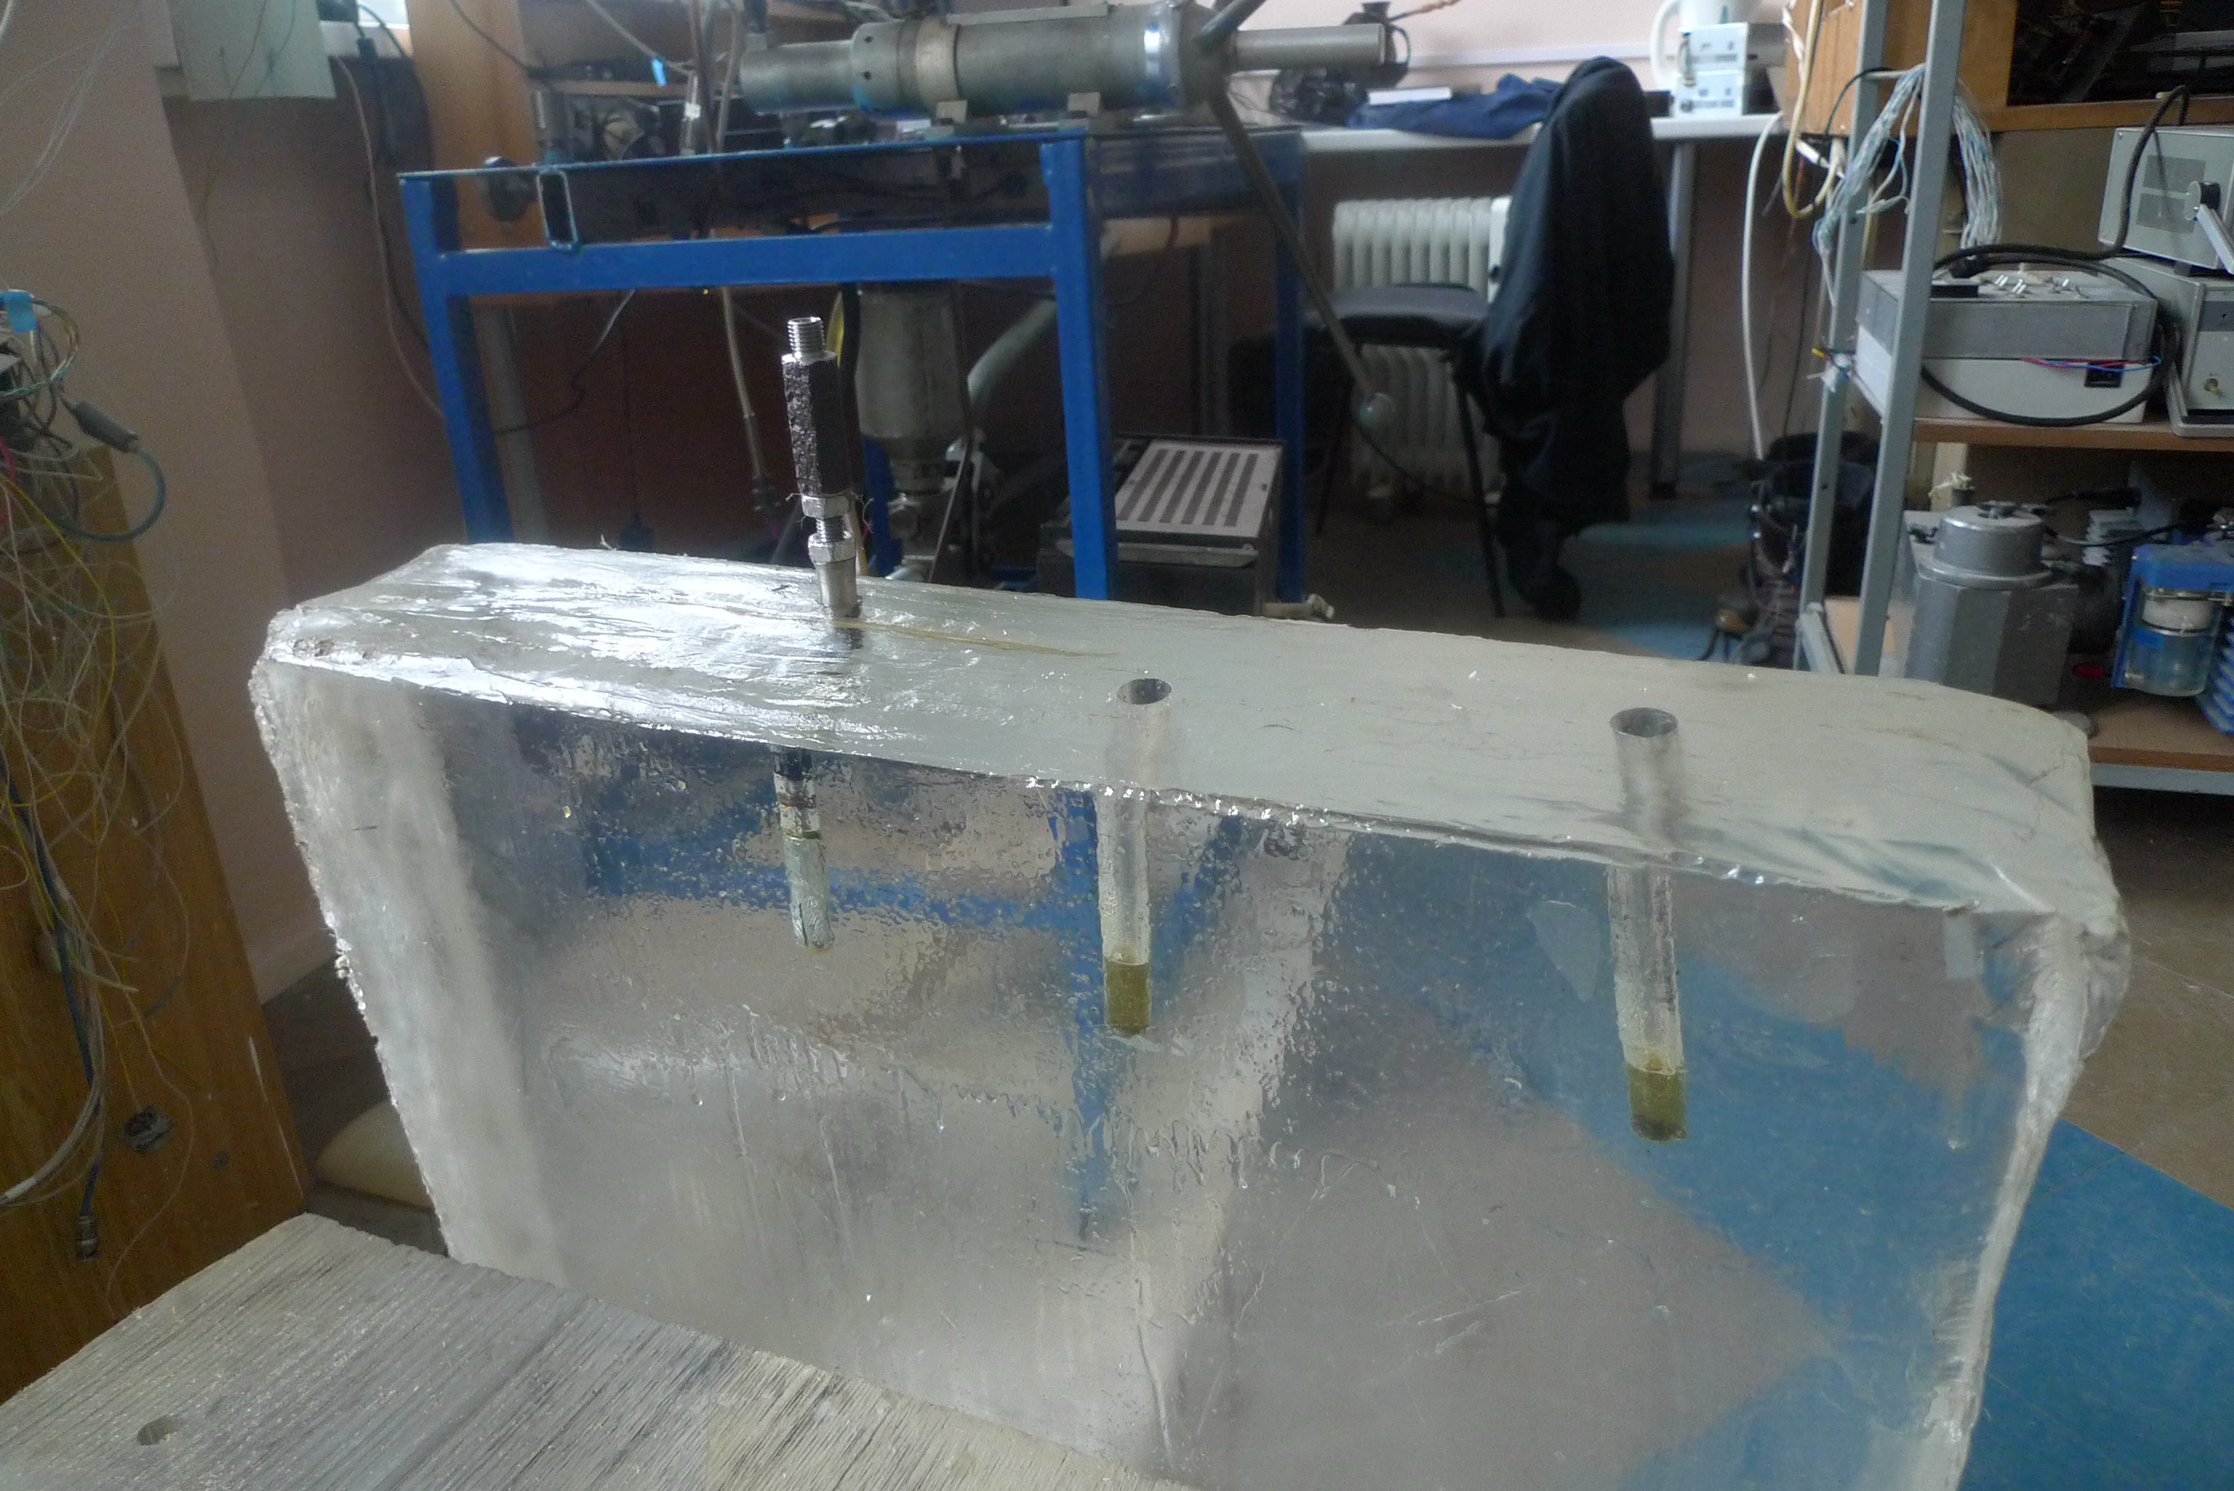
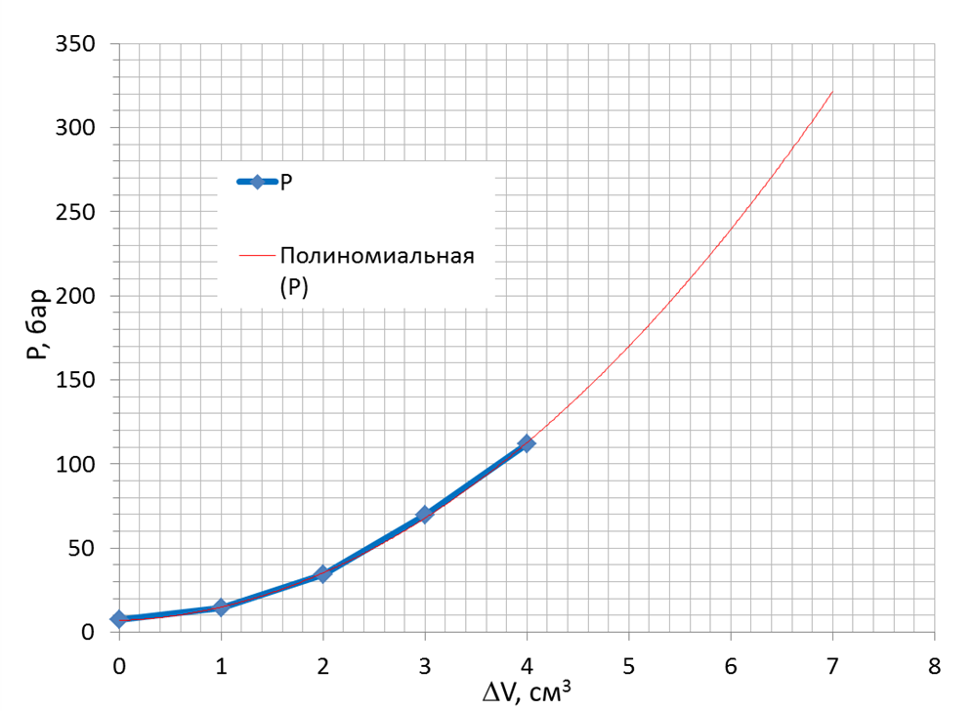
Sequence of operations
Preparation:
Drilling a hole, sealing a fracturing interval by a rubber, connecting to a hydraulic system, pumping oil to a pressure of 10 bar and regulating for leaks (simulating filtration into the rock)
Experiment:
Oil supply by a controlled volume pump with a low discharge rate + pressure and seismic signals recording
Plexiglass block with experimental holes
P
polynomial function
P, bar
P(ΔV) graph for hydraulic system with a hole
ΔV, cm³

Slide 6
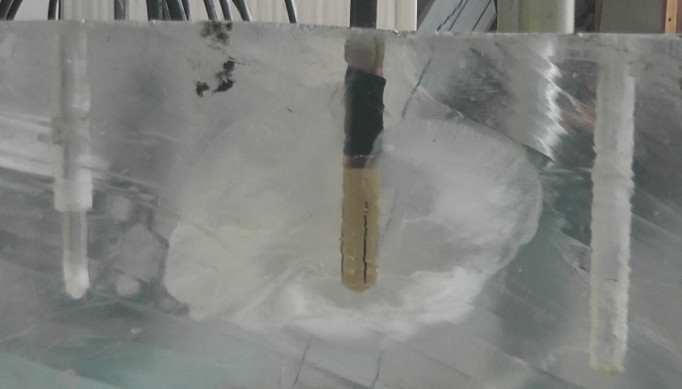
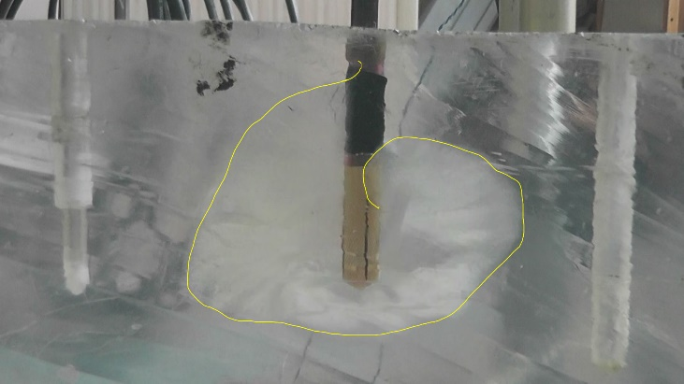
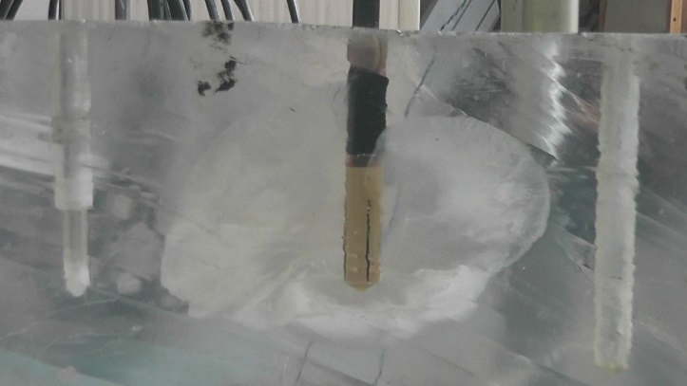
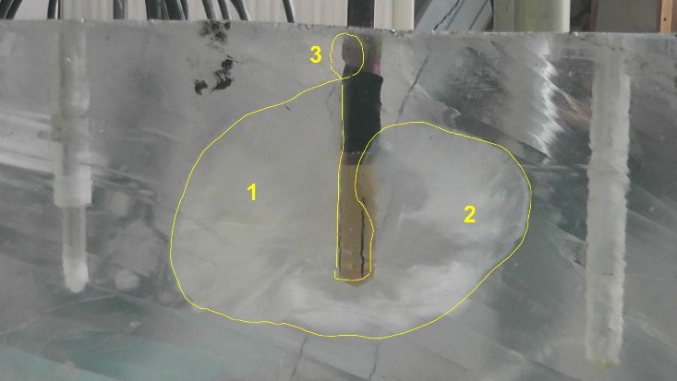
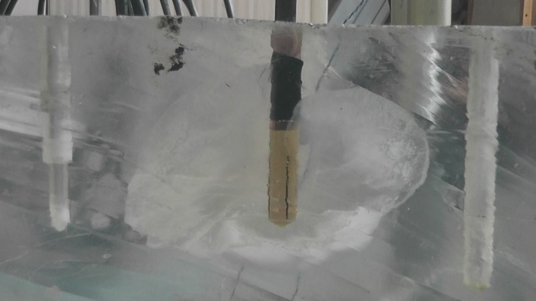
Longitudinal hydraulic fracturing
4
1 – left wing
2 – right wing (turn from the left one to 30°)
3 – packer bypass
4 – breakthrough to another crack
Crack almost does not grow down. Horizontal growth rate up to 2 m/s (frames 1-2).
Rate drops fast to 0.3 m/s (frames 2-3)
and further to cm/s.
The main fracturing phase lasts for 0.1 s. Then for 0.3-0.4 s the crack continues to fill with fluid and grows slightly.
1
4
2
5
3
6
Longitudinal fracturing video frames

Slide 7
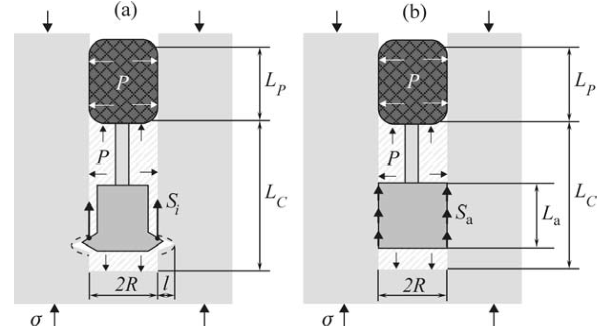
Transverse hydraulic fracturing method
Two schemes for the formation of a transverse fracture without additional cutting of the initiating crack were considered: anchor with and without indenter
The packer is fixed with an anchor in the fracturing interval
Working fluid pressure pushes the tool from the hole
Loading of the hole walls under hydraulic
fracturing with an anchor:
(a) the anchor with the indenter;
(b) the anchor without the indenter;
L_{P} —sealing interval; L_{C} —fracturing interval.

Slide 8
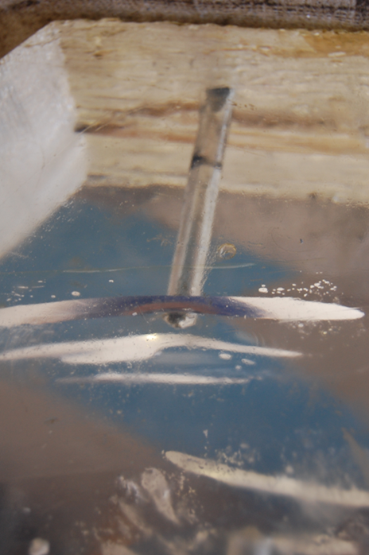
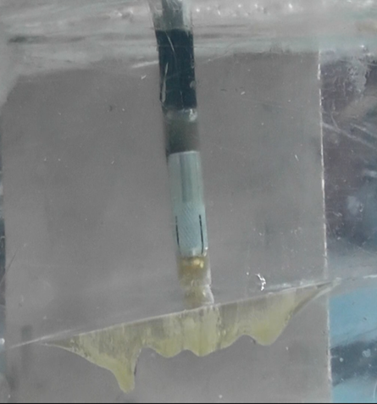
Transverse hydraulic fracturing
1 – breakthrough to the surface of the block
Transverse fracturing tool:
1 – collet anchor (with a ring groove b and an indenter a)
2 – cone
3 – gasket
4 – threaded coupling
5 – channel
6 – sealer
7 – washer
8 – pipe
9 – rod
10 – nut
11 – hydraulic inlet
1
Transverse fracturing results
Transverse fracturing tool

Slide 9
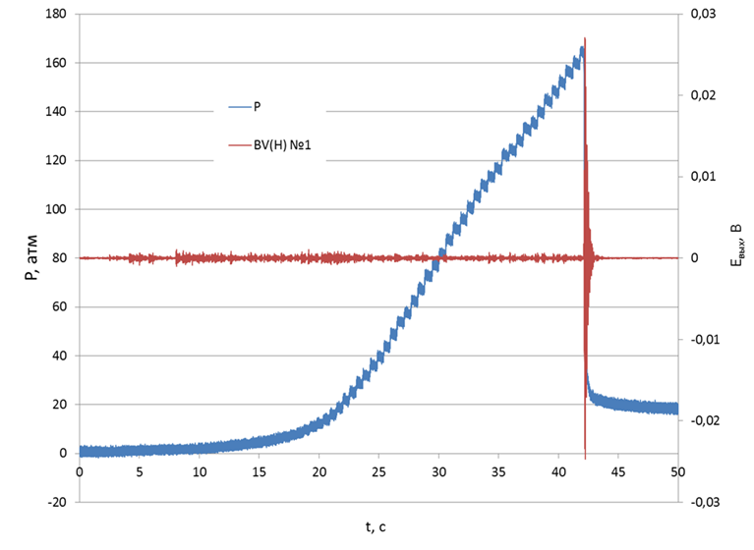
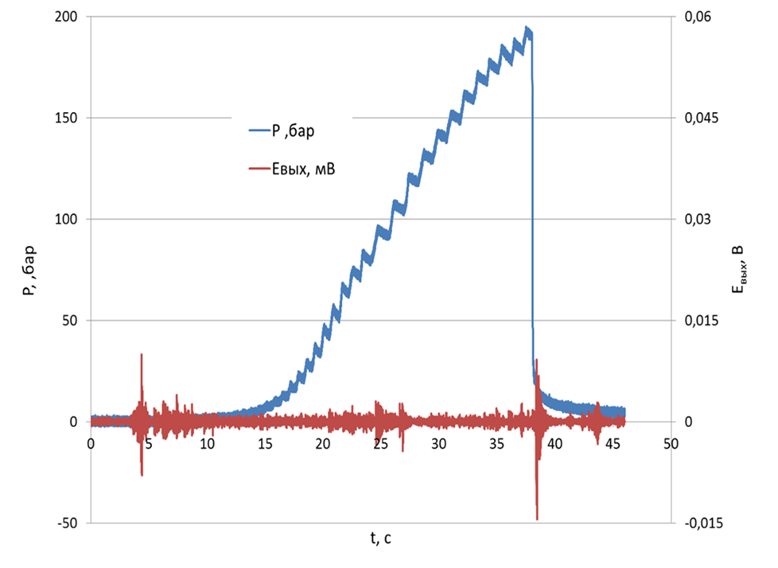
Pressure in the fracturing interval and seismic emission
Longitudinal
Transverse
P
E_{out}
P
E_{out}
P, bar
E_{out}, V
P, bar
E_{out}, V
t, s
t, s
Without crack breakthrough to the surface of the block Residual pressure – 20 bar
Crack breakthrough to the surface of the block
No residual pressure
Fracturing of plexiglass causes a surge in seismic emission with the highest level during longitudinal type

Slide 10
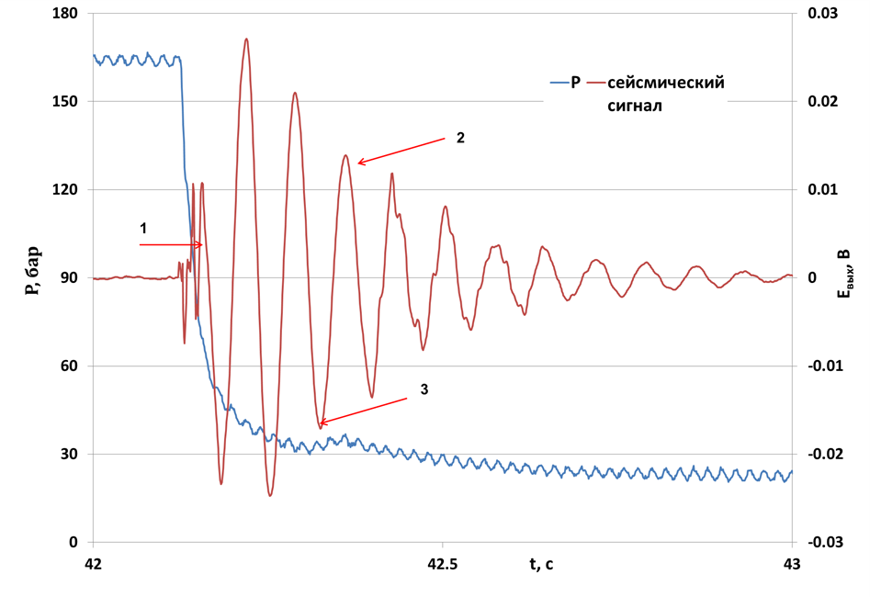
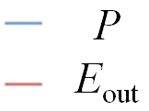
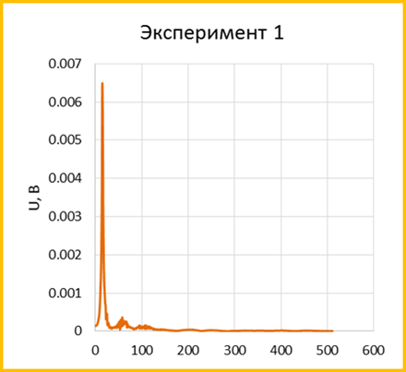
Seismic emission and its relation to HF
1 – short (80-100 ms) “high-frequency” (HF) pulse in the phase of rapid crack growth
2 – long (10-12 periods) "low-frequency" (LF) pulse in the form of a damped sinusoid
3 – pressure increase at the end after a sharp drop
P, bar
E_{out}, V
Signal spectrum
t, s
Working fluid pressure and seismic emission
Almost all seismic energy is concentrated in
LF pulse. It occurs after the phase of rapid crack growth.
U, V
f, Hz

Slide 11
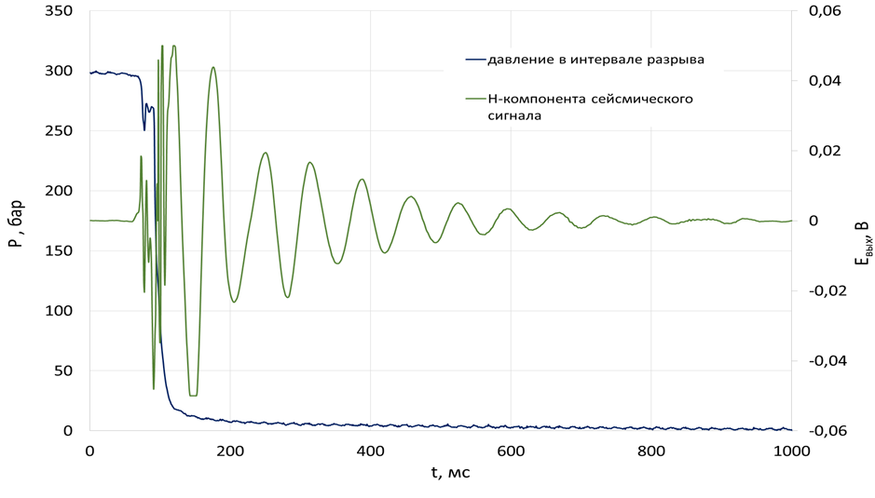
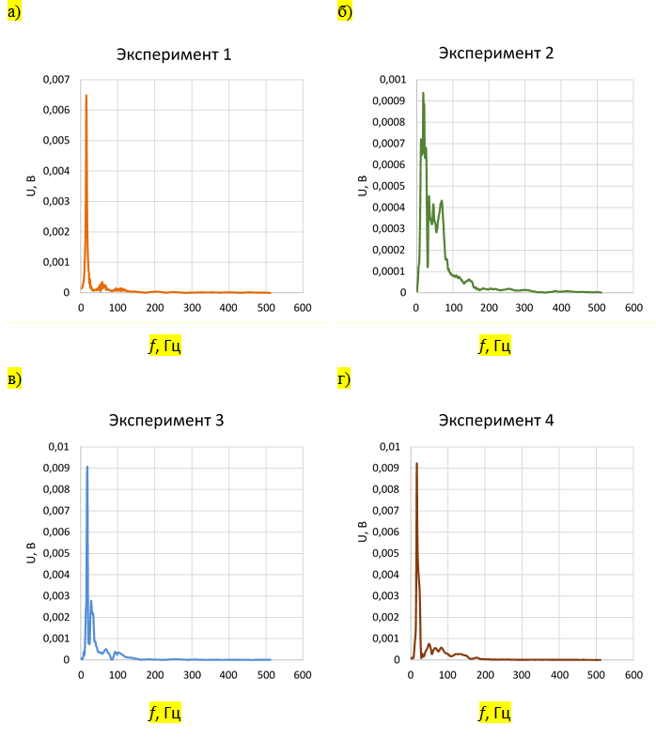
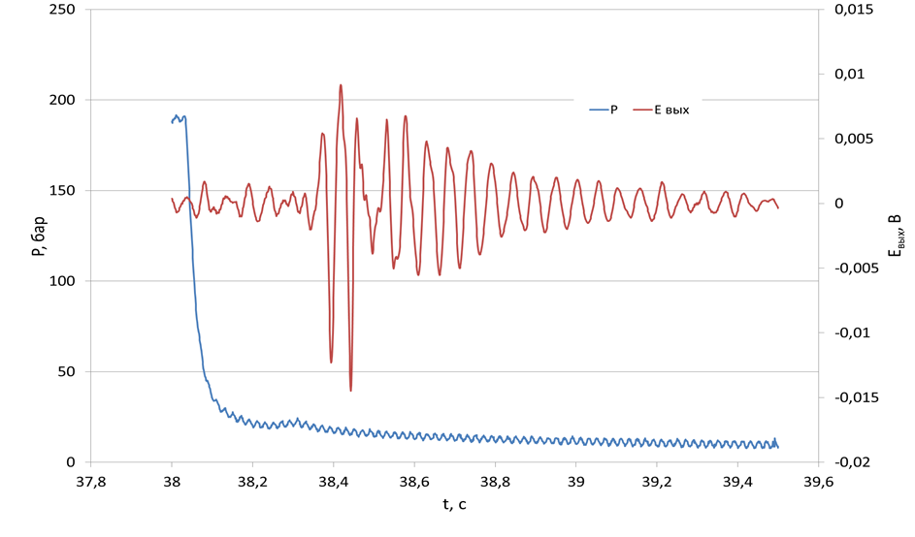
Examples
Longitudinal fracturing
Longitudinal fracturing spectra
P
E_{out}
E_{out}, V
P, bar
U, V
U, V
t, s
f, Hz
f, Hz
Transverse fracturing
E_{out}, V
U, V
U, V
P, bar
f, Hz
f, Hz
t, s

Slide 12
Quantitative estimates
LF seismic pulse:
seismic frequency – 15-18 Hz
pulse duration (average) – 547 ms
the oscillation amplitude of the medium (pulse averaged) – 4.8 microns
seismic energy flux density – 69 mW / m²
energy – 0.04 J
Changes in the state of the hydraulic system during HF:
crack radius – 9-10 cm
pressure drop (average) – 22.9 MPa
change in the elastic volume of the hydraulic system (average) – 5.2 cm³
change in energy of elastic volume compression (average) – 131 J
The main seismic emission during HF is LF, and occurs after the phase of rapid crack growth. We assume that the reason of the LF emission is the oscillations of the surfaces of an already formed crack when it is filled with working fluid and equalized in pressure when interacting with the hydraulic system of the equipment.
The energy of seismic emission is about 0.03% of the change in the energy of the elastic volume compression of the fracture hydraulic system.

Slide 13
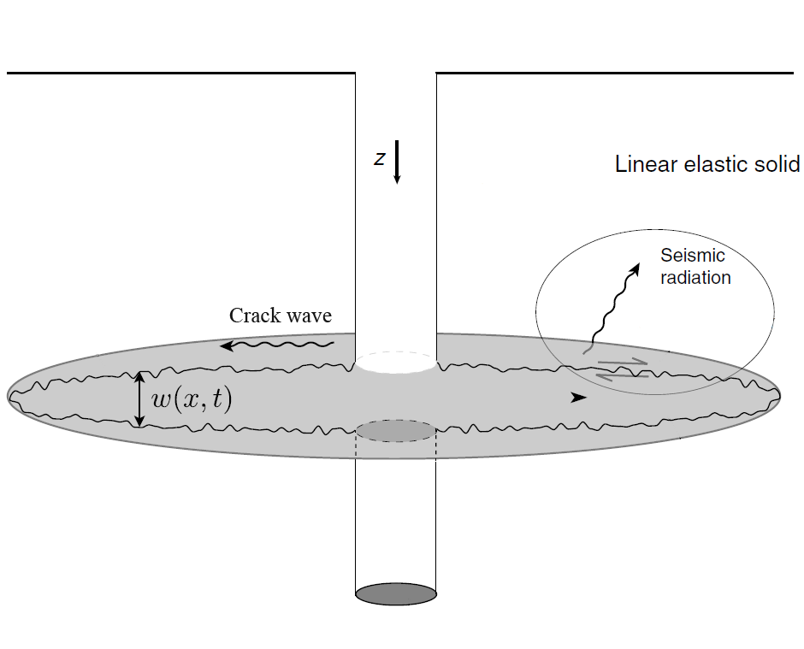
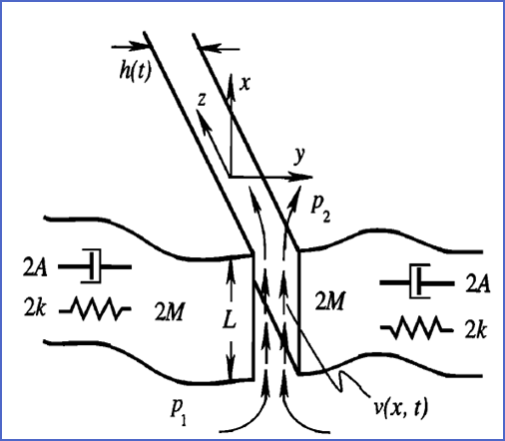
Model of the crack oscillation with fluid flow
Similar LF emissions have been observed and described for different cases:
1) hydraulic fracturing of oil wells;
2) water flows under the glaciers;
3) volcanic tremor during magma movement in faults
Perhaps these phenomena have a common mechanism for generating elastic oscillations associated with the movement of fluids in cracks
Models explaining long period harmonic events
Fluid-filled crack
Crack containing fluid flow
Seismic signals are explained by very slow and dispersive wave called "crack wave“ (Chouet, 1986; Liang, 2017)
Seismic signals are explained by self-excited oscillation caused by instability of Steady Flow (Julian, 1994; Balmforth, 2005)

Slide 14
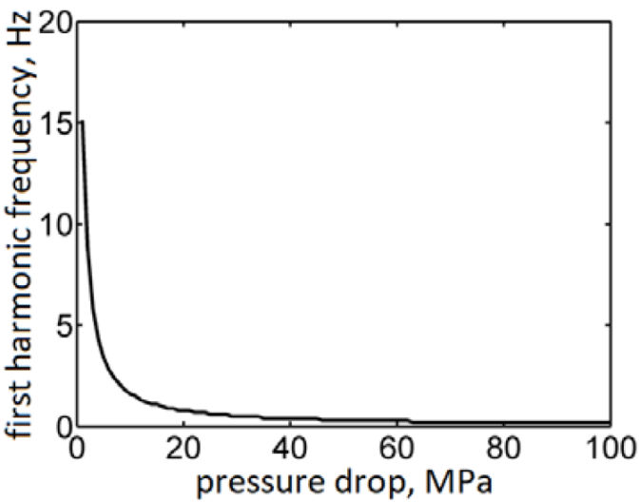
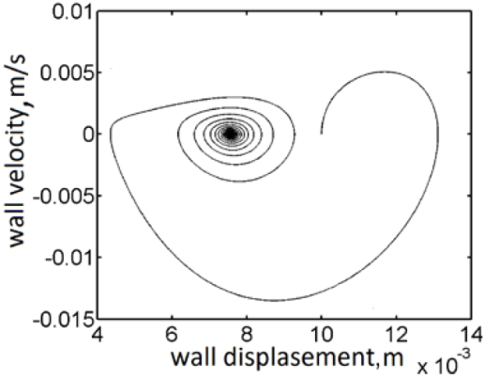
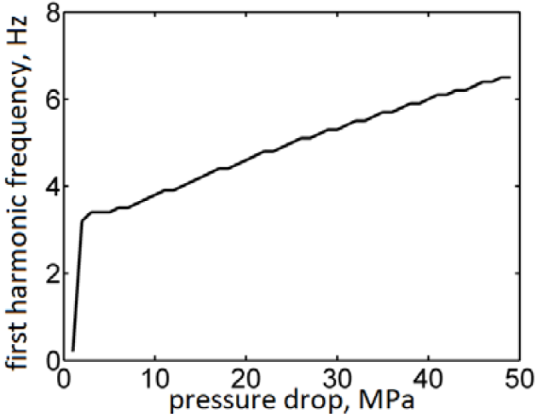
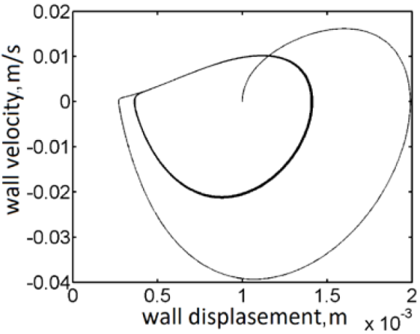
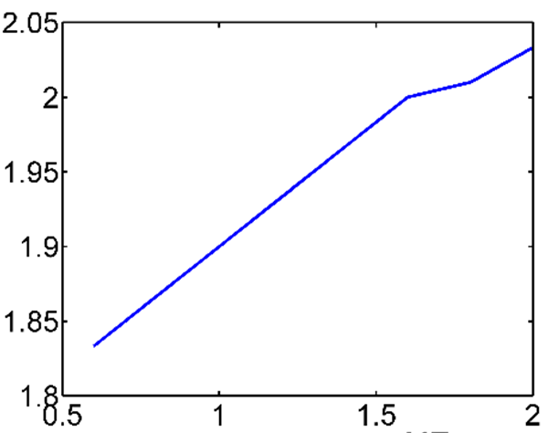
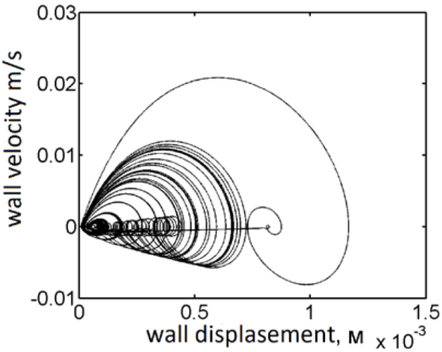
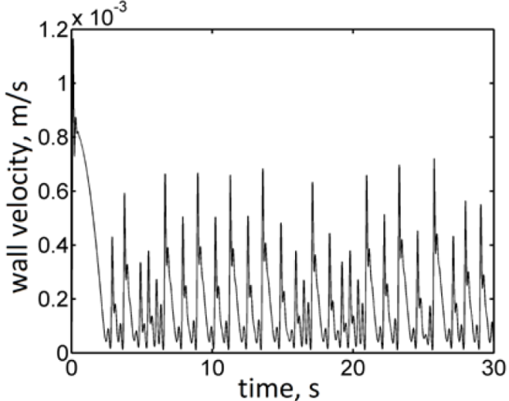
Crack emission estimates
1
Depending on the parameters of the system, oscillations of crack’s walls can be:
1) repetitive damped sine pulses
2) stable harmonic self-oscillations
3) chaotic oscillations
fracture length, m
2
The frequency of the first harmonic oscillations (cases 1-2) depends on the length of the crack and fluid flow.
If one of the parameters is known, then the value of another parameter can be determined from the spectrum of microseismic monitoring.
3
(Azarov et al., 2018)

Slide 15
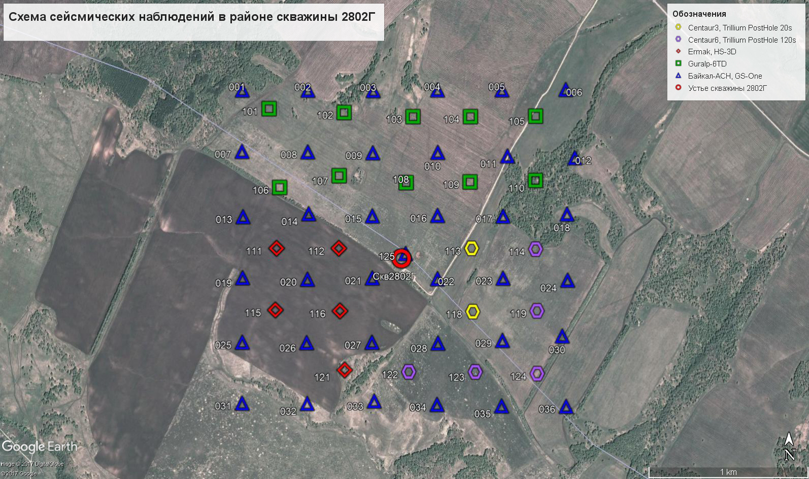
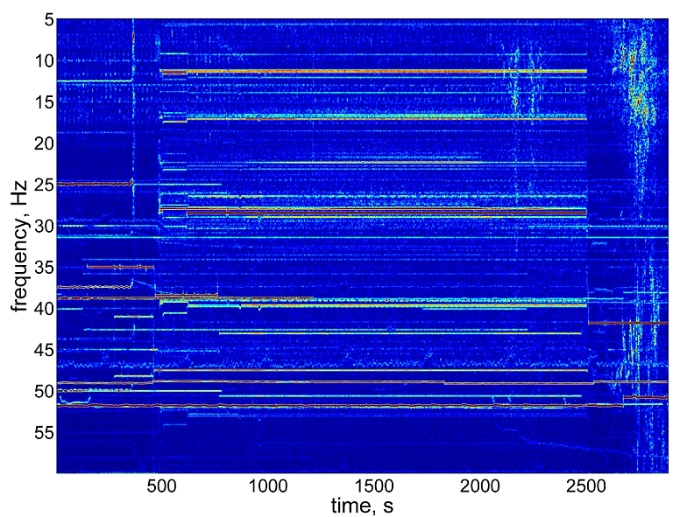
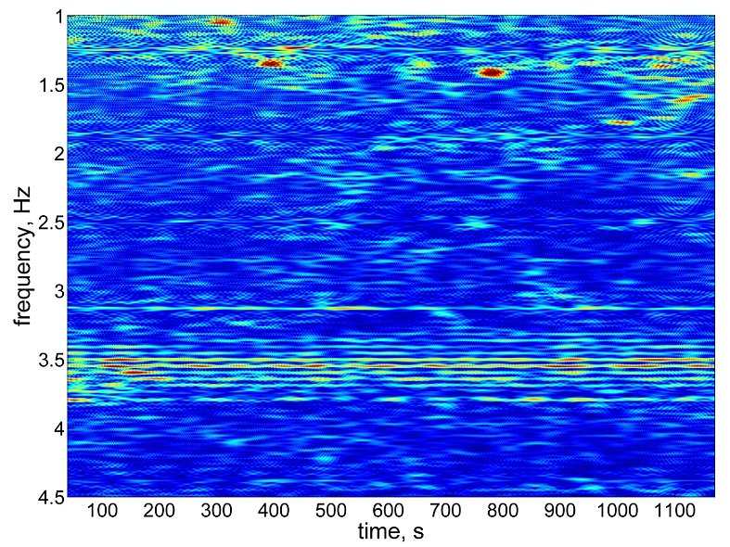
Search for LF signals in a full-scale experiment
Seismic scheme
Heterogeneous observation system for MSM during HF with several seismological sensors (20 sec and 120 sec).
Some of them didn’t work.
There are some LF oscillations, but in the conditions of intense low-frequency interference from ground-based sources we can not tie separate weak signals with HF.

Slide 16
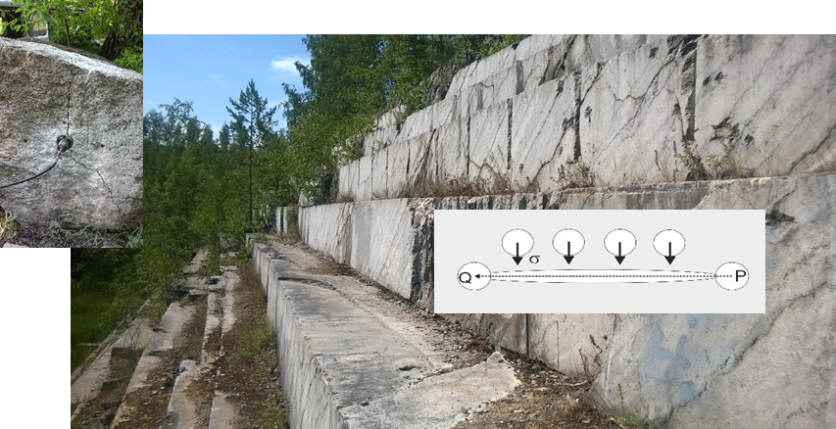
Seismic emission results
The degree of knowledge of the phenomenon is not sufficient for clear conclusions. For field detection of LF emission associated with fluid flow within the crack it is necessary to use borehole observation systems with sensitive low-frequency sensors, which is not yet realistic.
(Electromechanical coupling factor > 1000; natural frequency < 0.5 Hz)
What can these studies provide for exploration industry?
Early detection, location and remote monitoring of intensive filtration flows, for example, in salt mines
Improving the efficiency and reliability of MSM during HF for oil and gas production
New type of geophysical services for diagnosing the state of previously performed hydraulic fractures under hydrodynamic impact on them
We planned a full-scale experiment
on emission research while pumping fluid through the crack that is compressed by borehole jacks to simulate rock pressure.
Unfortunately, at the moment financing of the work is not received

Slide 17
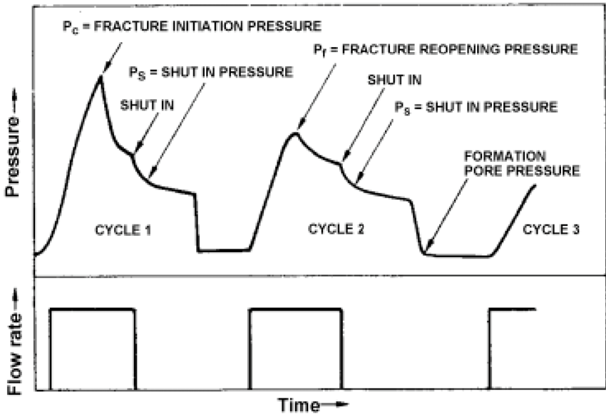
Determination of rock compression by the HF stress measurements (HFSM)
The classic approach adopted in underground construction and mining
no pore pressure
stresses normal to the fracture plane
Idealized pressure-time diagram
for hydraulic fracturing (ISRM, 1987)
Problem:
Due to working fluid penetration into the crack in repeated loading cycles
Pr equal to Ps, and σ_{max} can not be determined
(Cornet & Vallete, 1984, Ito et al., 2005, Zoback et al., 1977)
Objective of the study:
Validation of the second equation in the case of small mini-fracturing tests used in the HFSM method

Slide 18
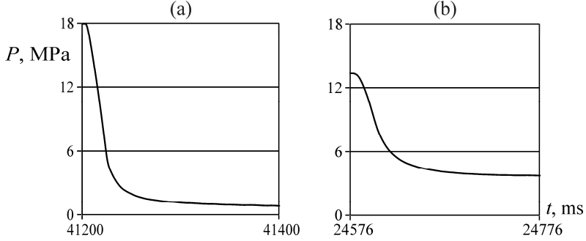
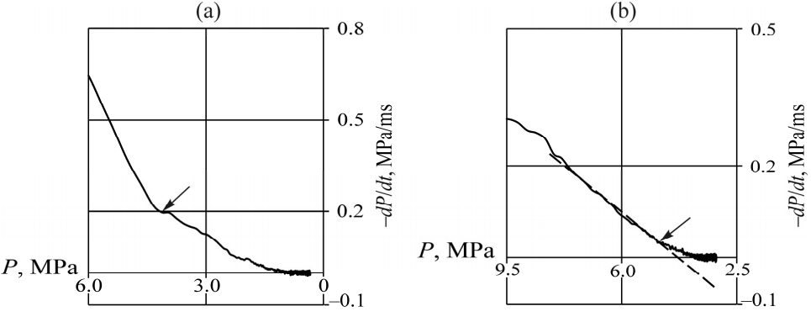
Shut-in pressure
a – crack with a radius of 94 mm with a breakthrough to the surface of the block
b – crack with a radius of 86 mm without breakthrough
Instantaneous shut-in pressure P_{isip} : 3.4 – 4.8 MPa
P_{asymp} : a) 0 MPa
b) 2.1 – 2.4 MPa
Working fluid pressure drop
Instantaneous shut-in pressure P_{isip} :
3.4 – 4.8 MPa
P_{asymp} : a) 0 MPa
b) 2.1 – 2.4 MPa
Identification of P_{S} based on the pressure drop

Slide 19
Shut in pressure and confining stress
P_{F} – disk fracture (R) propagation pressure with uniform pressure in it (no fluid leak-off)
K_{IC} – stress intensity factor (mode I, opening)
The P_{isip} value corresponds to P_{F}, which depends on R, i.e. P_{s} = σ_{min} + Δ(R)
For short cracks, P_{isip} is significantly larger than σ_{min}

Slide 20
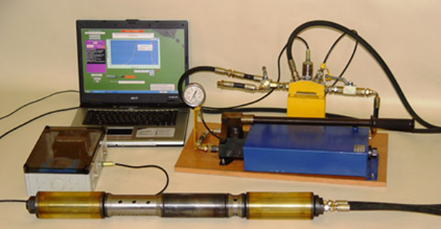
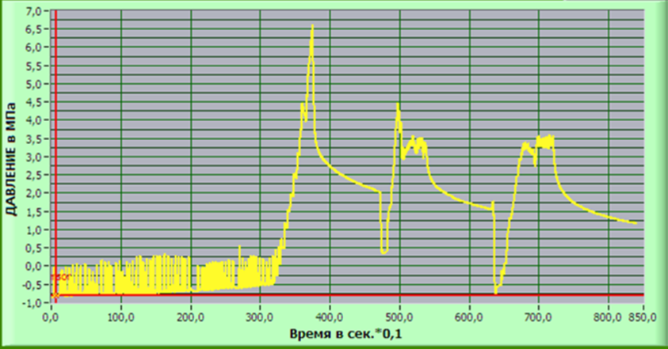
HFSM tool example
Developed in Institute of Mining SB RAS (Novosibirsk)
Specifications:
borehole diameter – 59-76 mm
HF interval – 300 mm
working fluid flow rate – 1-5 ml/s
HF pressure – up to 70 MPa
As an example, consider the pressure drop curve obtained from one of the potash mines
Shut-in pressure calculated with different approaches is 2.4-3.42 MPa,
average P_{s} is 3.2 MPa
From 3rd working cycle we get
P_{r} =3.3-3.4 MPa which is close to P_{s}
Borehole tool and measurement system
Pressure, MPa
Time, 0.1*s
Pressure-Time curve (Potash mine SKRU-3)
(Rubtsova, 2016; Leont’ev, 2010)

Slide 21
Interpretation errors according to the classic HFSM scheme
P_{r} = P_{s} in the experiment corresponds to modern concepts (Haimson, Ito, etc.) by which only minimal stress component can be determined using the HFSM method.
If we use the classic interpretation technique, we get a false equation σ_{max} ≈ 2σ_{min}
Crack radius R in the experiment was 0.3 m. Estimated value
for such a crack is 1.2 MPa.
σ_{min} and σ_{max} for classic HFSM scheme, MPa
σ_{min} and σ_{max} for P_{r} = P_{s} and R, MPa
6
3
?
2
The use of the classical interpretation scheme for HFSM data can lead to significant errors in the determination of compressive rock stresses. The length of the tool affects the accuracy of the stress measurement. The error is significant in the area of low stresses (under 5 MPa) and for HF interval shorter than 1 m.
(Serdyukov, 2016)

Slide 22
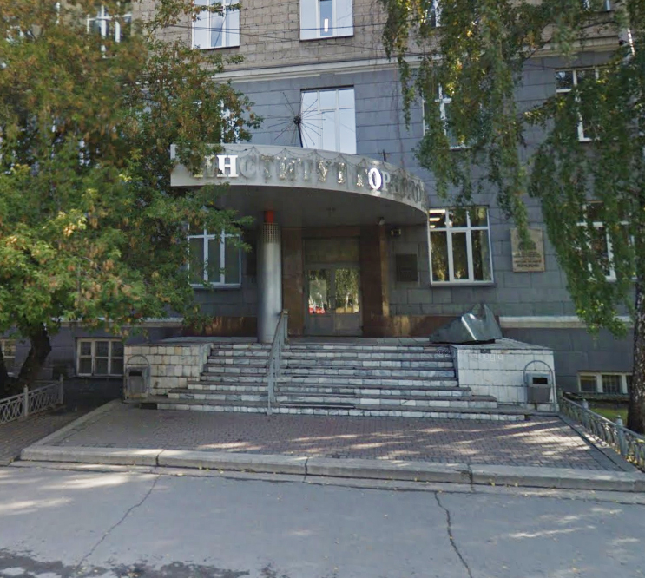
Thank you!
Andrey V. Patutin Leonid A. Rybalkin Sergey V. Serdyukov
PhD in Technical Sciences Junior Researcher Dr in Technical Sciences
Senior Researcher Head of the Laboratory
andrey.patutin@gmail.com leonid.rybalkin@gmail.com ss3032@yandex.ru
Lab of Physical Methods of Impact on the Rock Mass
Institute of Mining SB RAS
Novosibirsk, Russia

