Slide 1
Water hammer signatures in well dynamics
V.Yu. Liapidevskii^{1,2}, V.V. Neverov^{1,2}
¹Lavrentyev Institute of Hydrodynamics SB RAS, Novosibirsk, Russia
²Novosibirsk State University, Novosibirsk, Russia
Coupled thermo-hydro-mechanical problems of fracture mechanics
Novosibirsk, 2019

Slide 2
Water hammer analysis is a variant of the remote testing of the hydraulic fracturing treatment. It includes the acoustic signal restoring by the model containing a number of free parameters and calculating the fracture characteristic by the found parameters.
The problem under consideration is to find the optimal set of governing parameters and to connect them with a fracture geometry.
In contrast to the existing WH models, we are going to show that for some cases described in the open literature the water hammer signature can be restored from the data registered during the treatment. It may change the approach to the problem.
Outline
Introduction
Acoustical methods of wellbore – fracture diagnostic
Mathematical models of wave motion in wellbores
Verification of the models:
Hydraulic Impedance Testing
Water hammer in experimental vertical wellbores
Water hammer signature in horizontal wellbores
Conclusions

Slide 3
Introduction
It is necessary to have information about fracture during the Hydraulic Fracturing procedure. One of the methods to estimate fracture parameters is the analysis of a series of pressure pulses observed after sudden pump shutdown known as water hammer (WH).
The water hammer phenomenon was first described by Joukowsky (1900), but the effect of fractures on the pressure signal was studied much later by Khalevin (1960), Morris (1964) and others. In the year 1985 Holzhausen and Gooch proposed the method of Hydraulic Impedance Testing (HIT), which consisted of sending single pressure pulse and analyzing the reflected pressure oscillations.
Also Holzhausen and Gooch (1985) proposed a model for WH treating the wellbore with fracture as a large circuit. Shlyapoberdsky et al. (1988) proposed method to obtain fracture dimensions from free parameters of model. Lastly, such model have been applied recently for calculation of water hammer signature in Patzek et al. (1999), Carey et al. (2014) and Hwang et al. (2017).
The high-frequency pressure monitoring technology (HFPM) is a novel method of remote hydraulic fracturing analysis based on automatic processing of wellbore pressure oscillations recorded at the wellhead (Bogdan et al., 2016; Panjaitan et al., 2018; Parkhonyuk et al., 2018). It is related to HIT method and that utilizes advanced signal processing and machine learning for automatic fluid entry point determination.
HFPM is not considered in the presentation.
In this work we are focused on developing the model of WH from basic principles and on the optimal parameters choice to provide good accordance between numerical and experimental data.

Slide 4
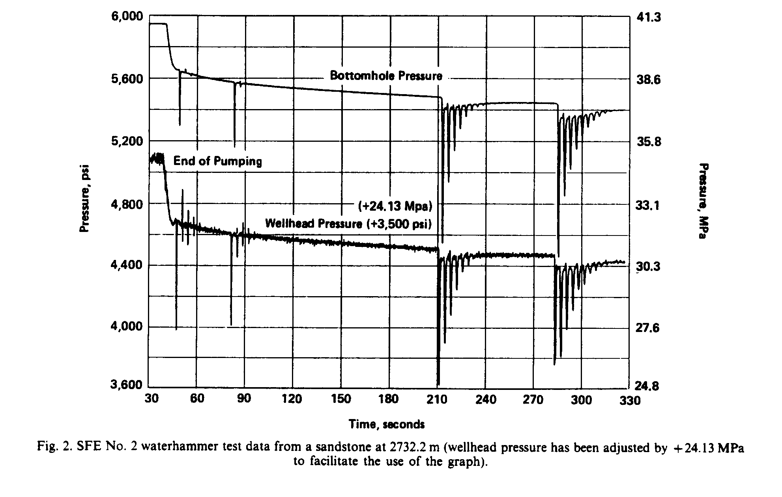
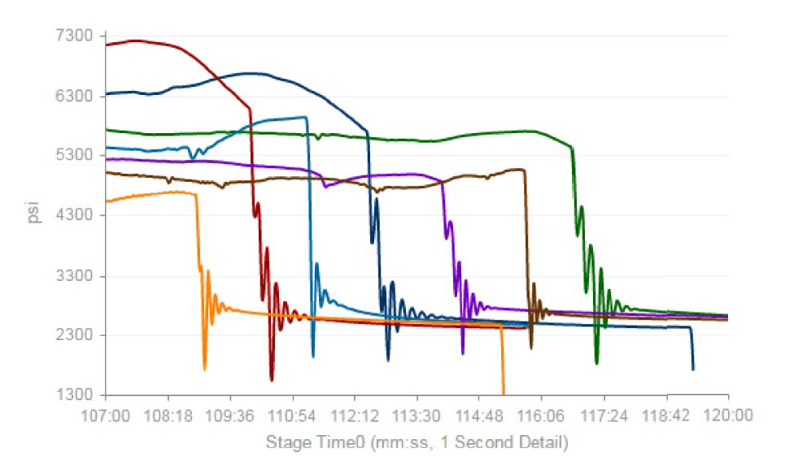
Acoustical methods of wellbore – fracture diagnostic
Hydraulic Impedance Testing (HIT)
(Holzhausen et al. 1985, 1986, 1989)
Method HIT is realized by sending a single artificially produced pressure pulse from the surface and analyzing the reflected pressure oscillations.
Water hammer signatures in well dynamics (Iriarte et al, 2017)
A water hammer signal consists of a series of pressure pulses and frequently occurs during hydraulic fracture treatment. The analysis of water hammer signatures (amplitude, period, duration, decay rate etc.) can provide additional diagnostic information on fracture geometry.

Slide 5
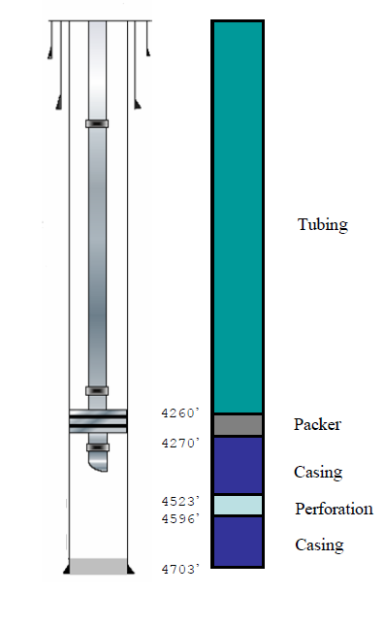
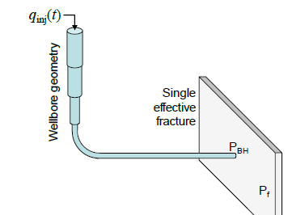
To test out models we used data from several WH events taken from the free sources
Vertical wellbores:
Holzhausen et al., 1989 (method HIT);
Wang et al., 2008 (WH analysis);
Patzek & De, 2000 (WH analysis of fracture closing);
Horizontal wellbores:
Hwang et al., 2017 (WH signature analysis)

Slide 6
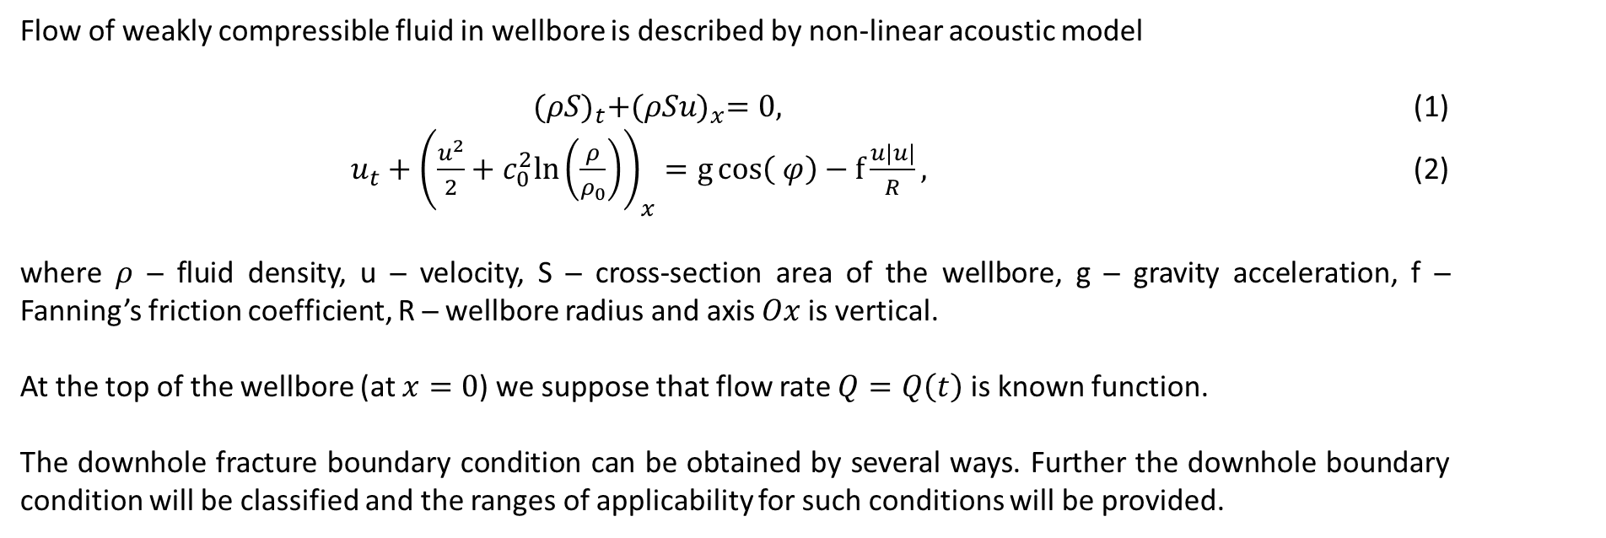
Mathematical models of wave motion in wellbores
Flow of weakly compressible fluid in wellbore is described by non-linear acoustic model
${(ρS)}_{t}+{(ρSu)}_{x}=0,$ (1)
$u_{t}+{\left(\frac{u^{2}}{2}+c_{0}^{2}ln\left(\frac{ρ}{ρ_{0}}\right)\right)}_{x}=g\cos\left( φ\right)−f\frac{u|u|}{R},$ (2)
where $ρ$ ─ fluid density, u ─ velocity, S ─ cross-section area of the wellbore, g ─ gravity acceleration, f ─ Fanning’s friction coefficient, R ─ wellbore radius and axis $Ox$ is vertical.
At the top of the wellbore (at $x=0$) we suppose that flow rate $Q=Q\left(t\right)$ is known function.
The downhole fracture boundary condition can be obtained by several ways. Further the downhole boundary condition will be classified and the ranges of applicability for such conditions will be provided.

Slide 7
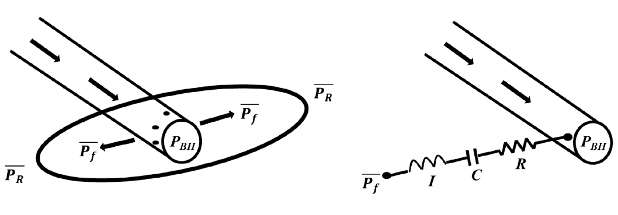
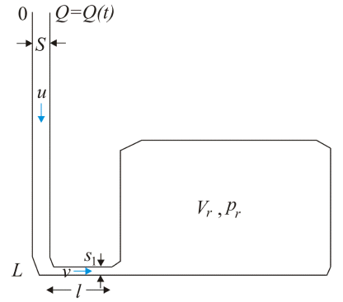
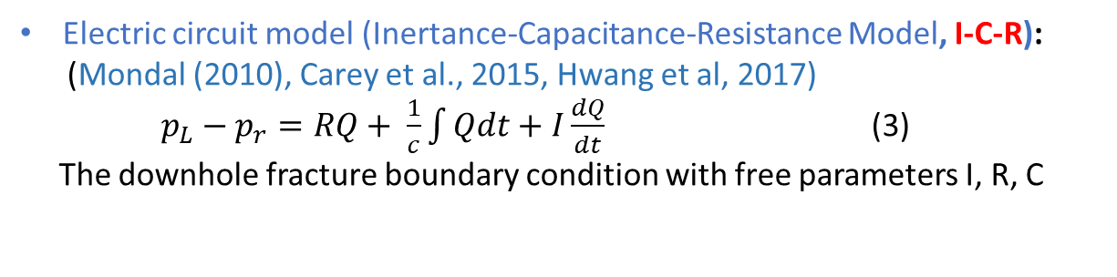
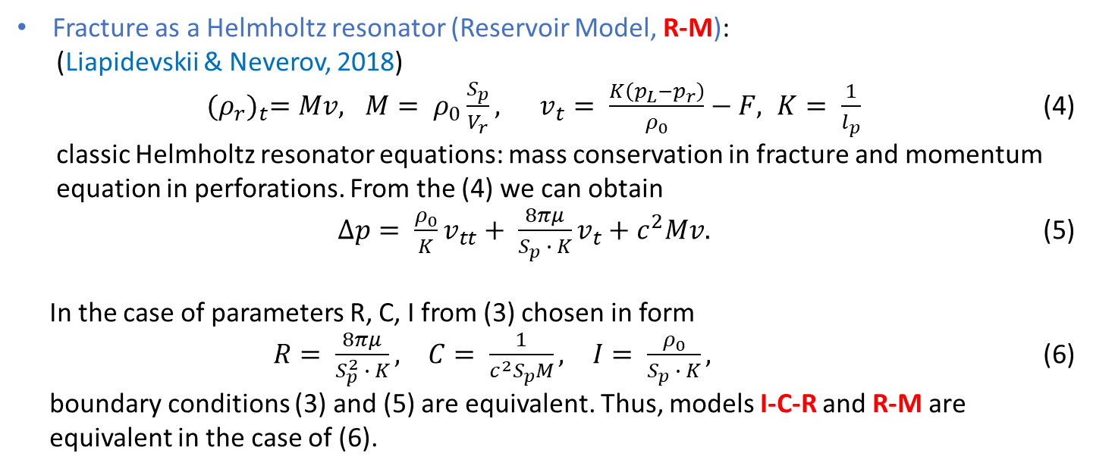
Mathematical models of wave motion in wellbores
Electric circuit model (Inertance-Capacitance-Resistance Model, I-C-R):
(Mondal (2010), Carey et al., 2015, Hwang et al, 2017)
$p_{L}−p_{r}=RQ+ \frac{1}{c}\int{Qdt}+I\frac{dQ}{dt}$ (3)
The downhole fracture boundary condition with free parameters I, R, C
Fracture as a Helmholtz resonator (Reservoir Model, R-M):
(Liapidevskii & Neverov, 2018)
${(ρ_{r})}_{t}=Mv, M= ρ_{0}\frac{S_{p}}{V_{r}}, v_{t}= \frac{K\left(p_{L}−p_{r}\right)}{ρ_{0}}−F, K= \frac{1}{l_{p}}$ (4)
classic Helmholtz resonator equations: mass conservation in fracture and momentum
equation in perforations. From the (4) we can obtain
$∆p= \frac{ρ_{0}}{K}v_{tt}+ \frac{8πμ}{S_{p} ∙ K}v_{t}+c^{2}Mv.$ (5)
In the case of parameters R, C, I from (3) chosen in form
$R= \frac{8πμ}{S_{p}^{2} ∙ K}, C= \frac{1}{c^{2}S_{p}M}, I= \frac{ρ_{0}}{S_{p} ∙ K},$ (6)
boundary conditions (3) and (5) are equivalent. Thus, models I-C-R and R-M are
equivalent in the case of (6).

Slide 8
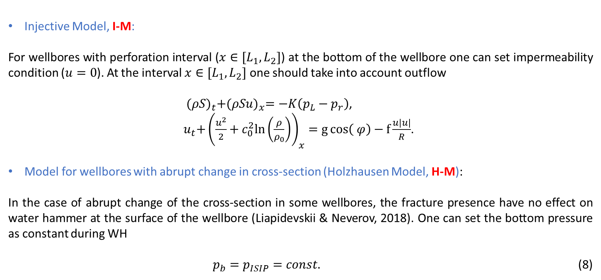
Mathematical models of wave motion in wellbores
Injective Model, I-M:
For wellbores with perforation interval ($x∈[L_{1},L_{2}]$) at the bottom of the wellbore one can set impermeability condition ($u=0$). At the interval $x∈[L_{1},L_{2}]$ one should take into account outflow
${(ρS)}_{t}+{(ρSu)}_{x}=−K\left(p_{L}−p_{r}\right)$,
${ u}_{t}+{\left(\frac{u^{2}}{2}+c_{0}^{2}ln\left(\frac{ρ}{ρ_{0}}\right)\right)}_{x}=g\cos\left( φ\right)−f\frac{u|u|}{R}$.
Model for wellbores with abrupt change in cross-section (Holzhausen Model, H-M):
In the case of abrupt change of the cross-section in some wellbores, the fracture presence have no effect on water hammer at the surface of the wellbore (Liapidevskii & Neverov, 2018). One can set the bottom pressure as constant during WH
$p_{b}=p_{ISIP}=const.$ (8)

Slide 9
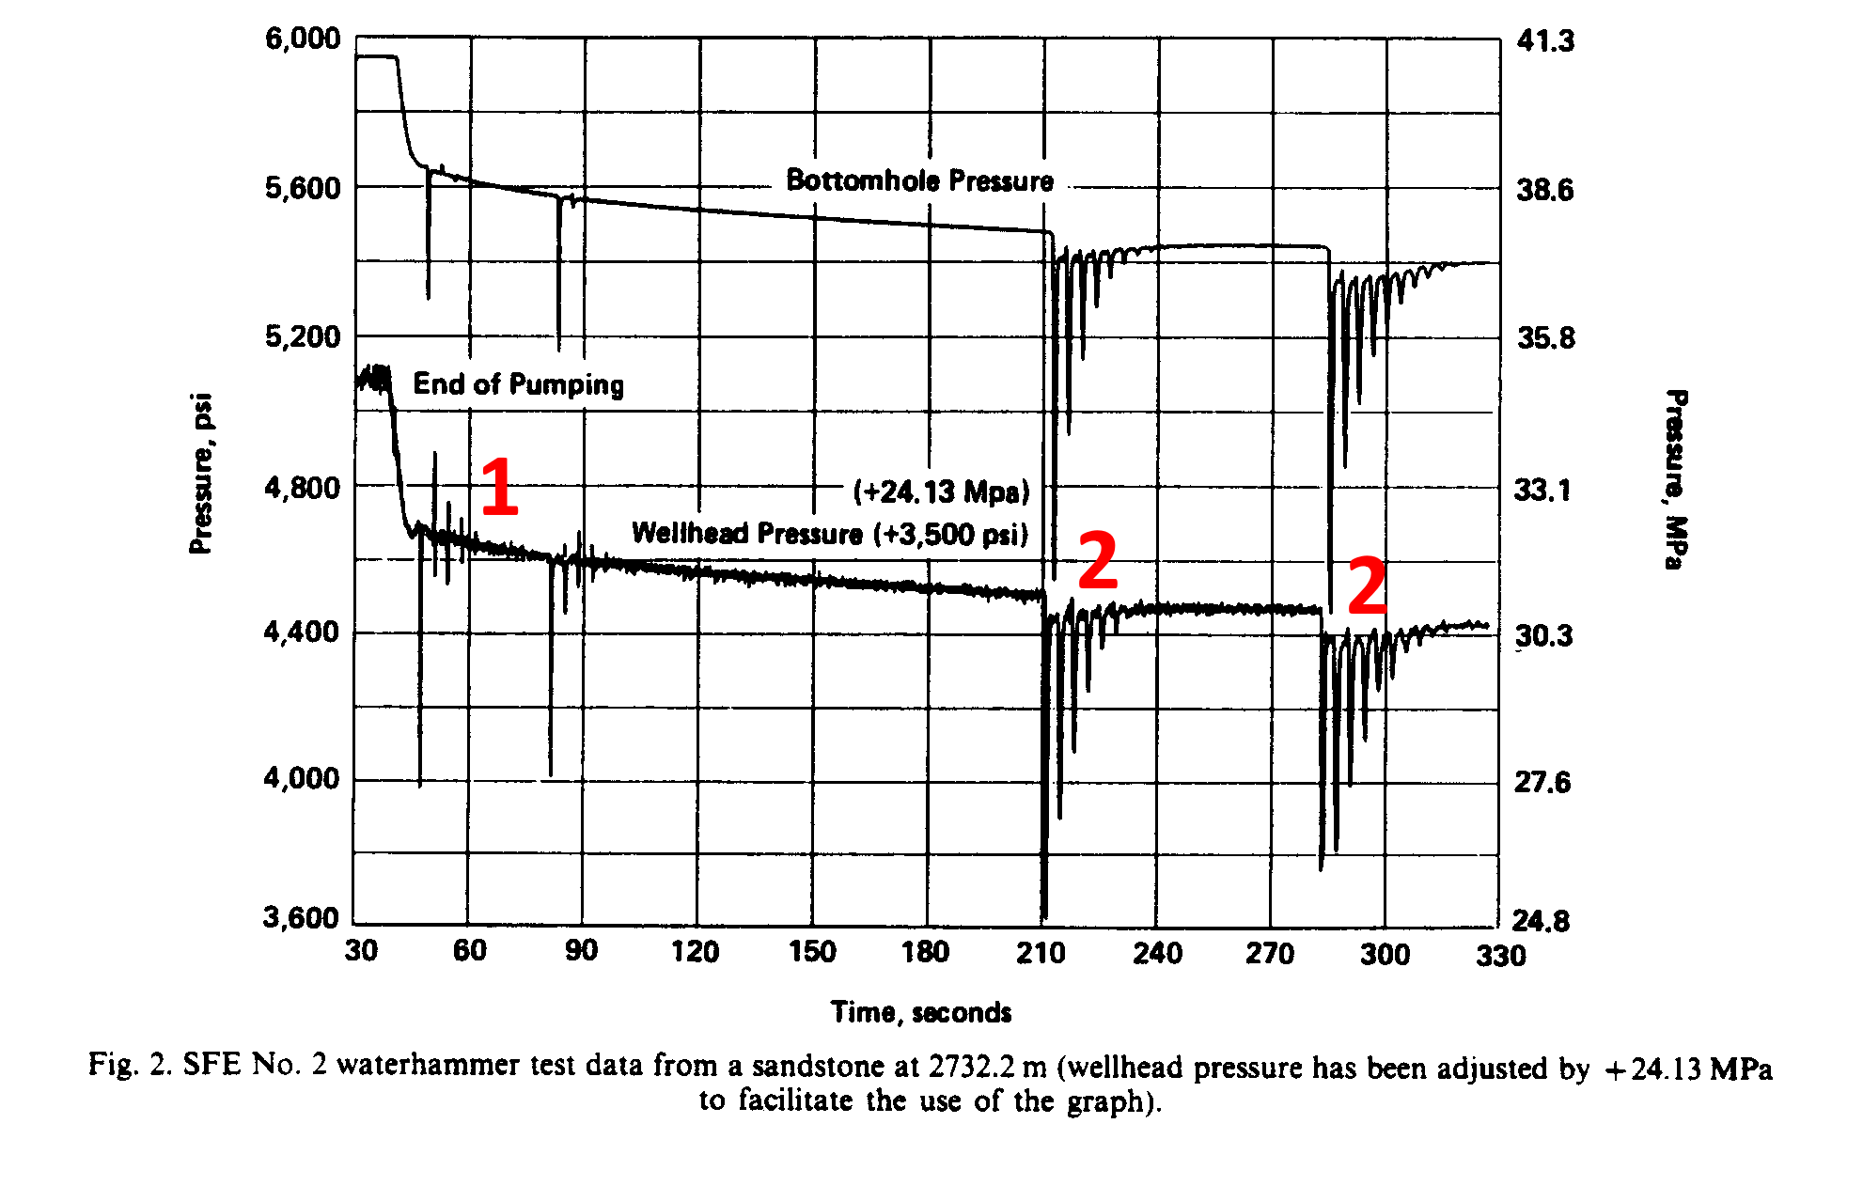
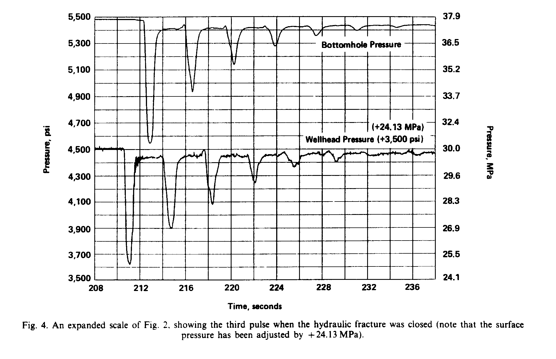
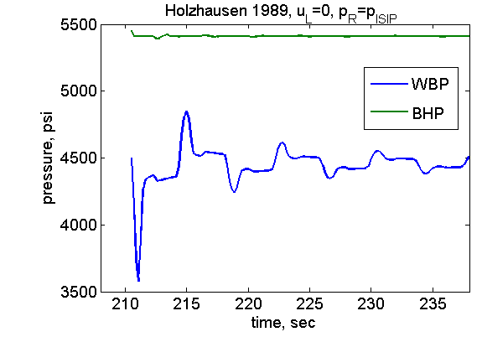
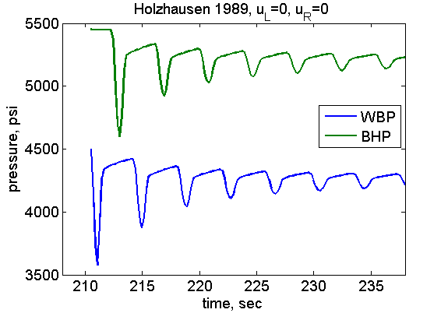
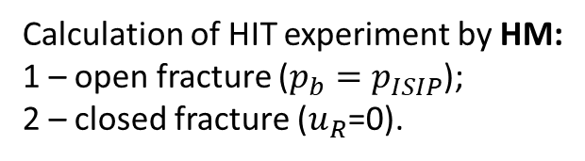
Hydraulic Impedance Testing (HIT)
2
HIT analysis of a vertical injective wellbore after end of pumping
(Holzhausen et al., 1989):
1 – open fracture;
2 – closed fracture
1
2
Calculation of HIT experiment by HM:
1 – open fracture ($p_{b}=p_{ISIP}$);
2 – closed fracture ($u_{R}$=0).

Slide 10
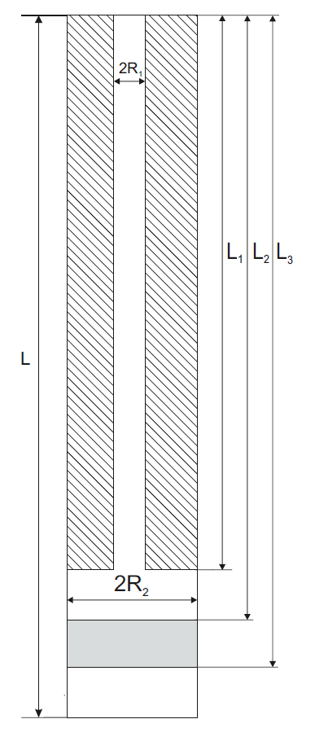
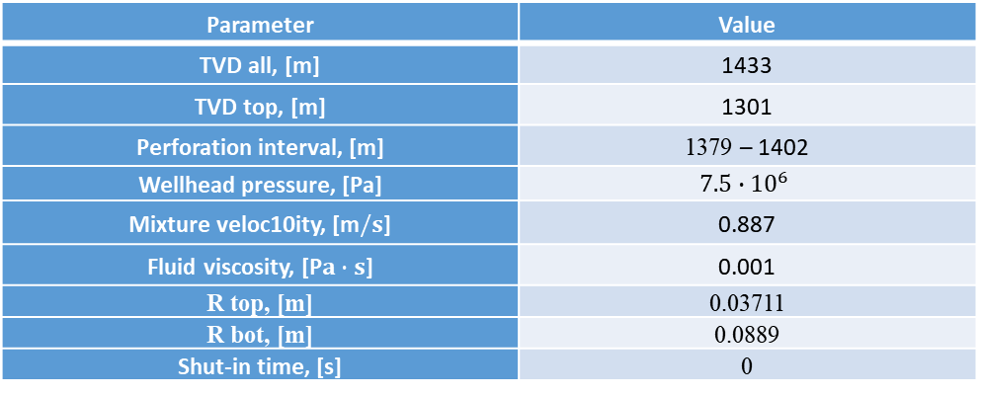
Experimental wellbore (Wang, 2008)
Wang (2008) described water hammer in the experimental wellbore schematically drawn at the picture.
Numerical calculations for such case have been obtained and a comparison with the Wang experiment have been performed. Since the experimental well consisted of two parts with different cross-area, the flow in this parts can be calculated separately.
Parameter | Value
TVD all, [m] | 1433
TVD top, [m] | 1301
Perforation interval, [m] | 1379 – 1402
Wellhead pressure, [Pa] | $$7.5∙{10}^{6}$$
Mixture veloc10ity, [m$/s$] | 0.887
Fluid viscosity, [P$a∙s$] | 0.001
R top, [m] | 0.03711
R bot, [m] | 0.0889
Shut-in time, [s] | 0
Schematic picture of the experimental wellbore
A number of downhole pressure gauges was lowered into the well. Three predefined depths were selected : 229 m, 762 m and 1356 m. The downhole gauges recorded pressure as a function of time at 100 samples per second (high frequency).

Slide 11
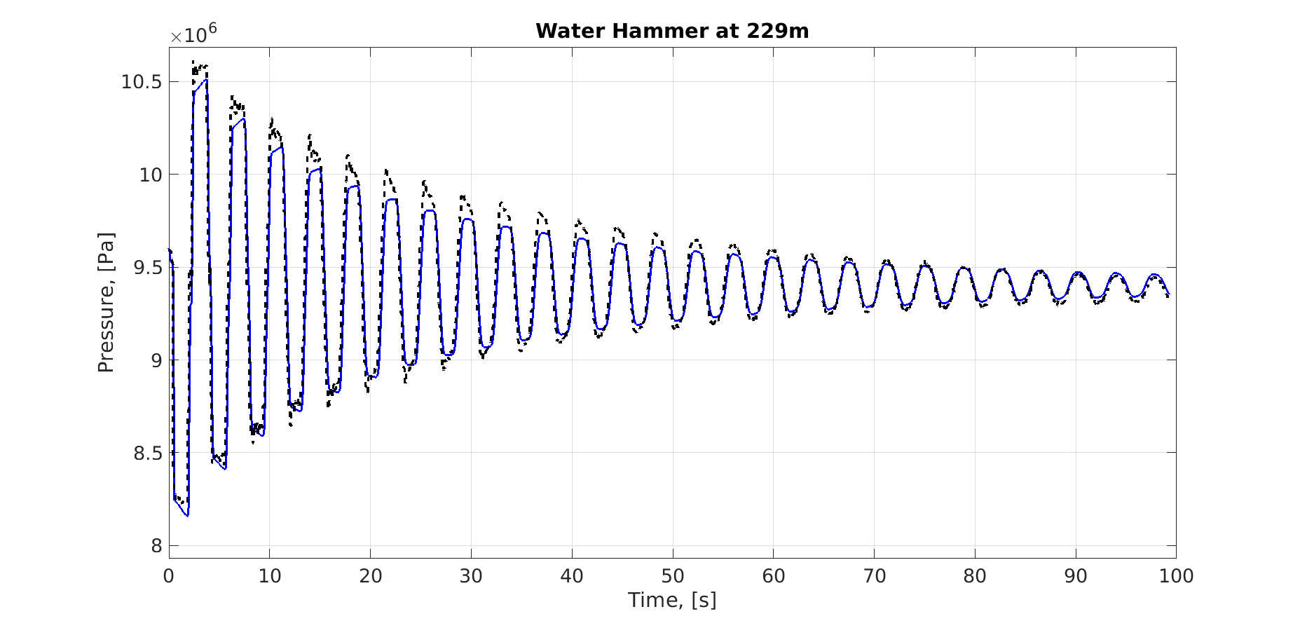
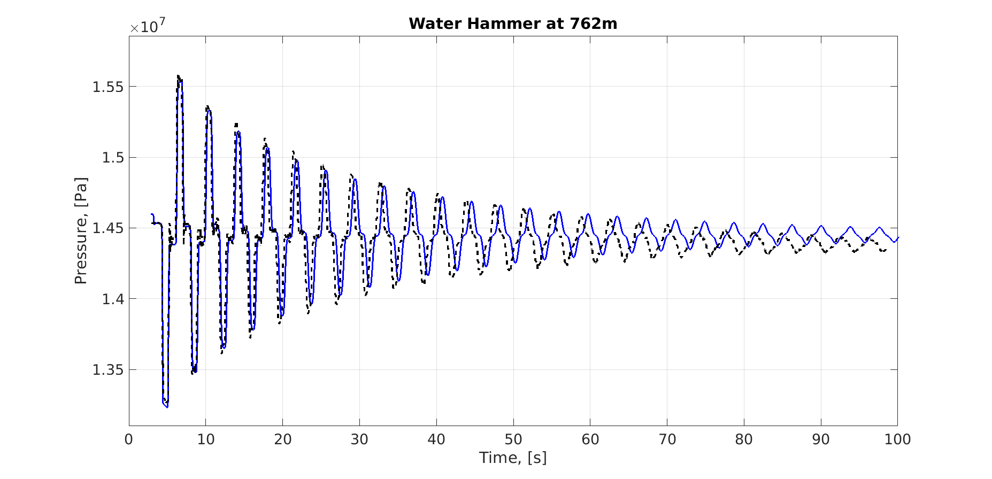
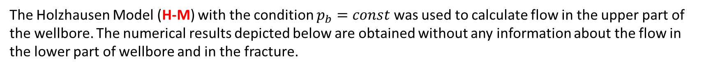
Experimental wellbore (Wang, 2008)
The Holzhausen Model (H-M) with the condition $p_{b}=const$ was used to calculate flow in the upper part of the wellbore. The numerical results depicted below are obtained without any information about the flow in the lower part of wellbore and in the fracture.
Water hammer at 229m and 762m, blue line ─ calculations, dashed line ─ experimental data

Slide 12
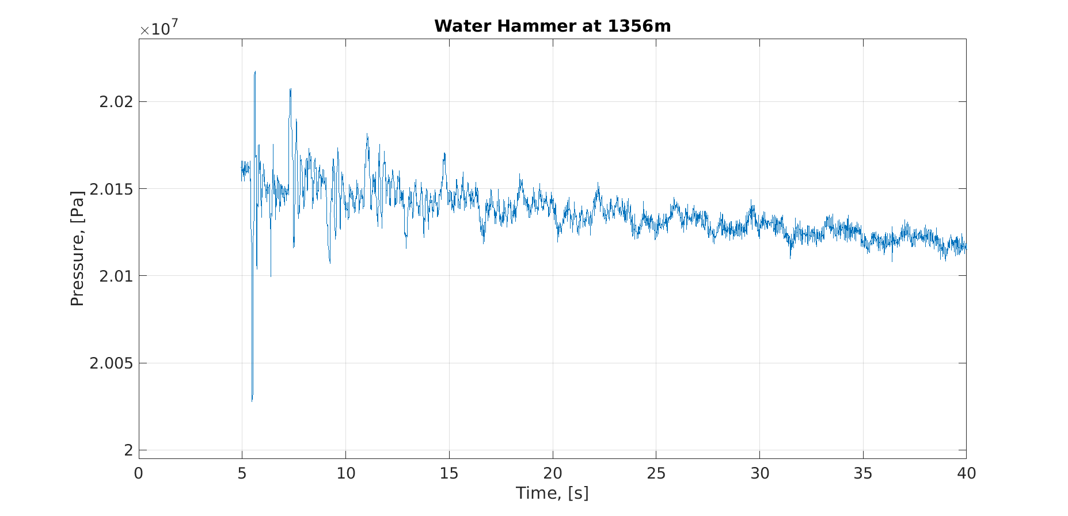
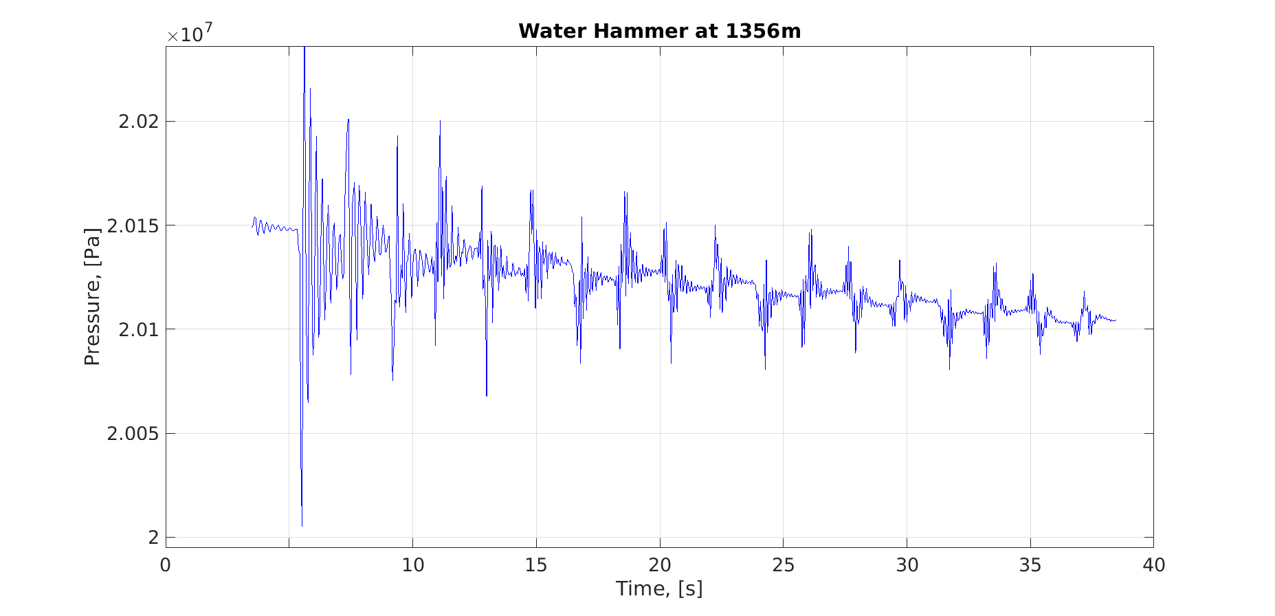
Experimental wellbore (Wang, 2008)
The Injective model (I-M) was used to calculate flow in the lower section. Calculated pressure in the upper section was used as a boundary condition at the section jump point.
Water hammer at 1356m, right line ─ calculations and left line depicts experimental data

Slide 13
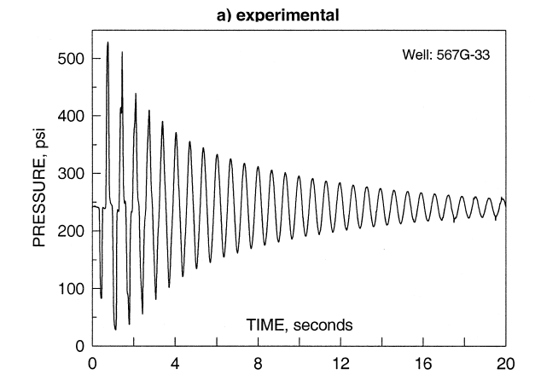
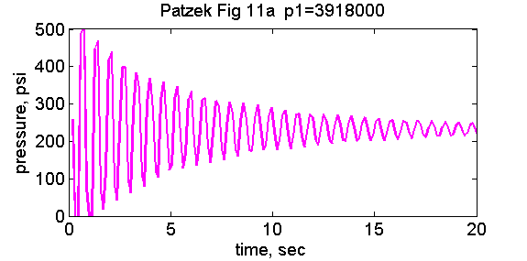
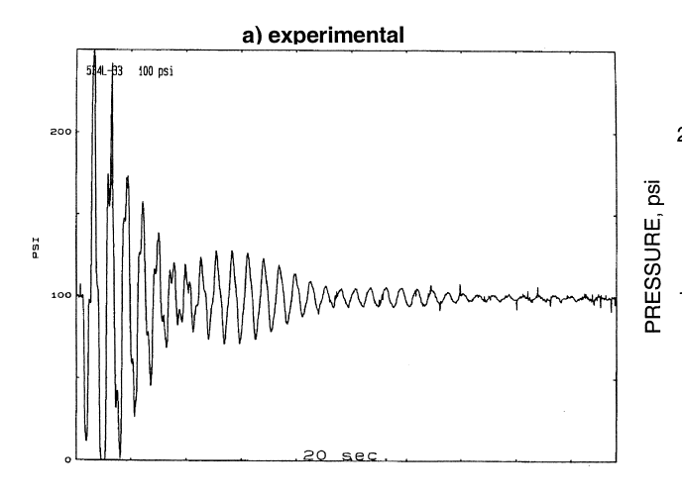
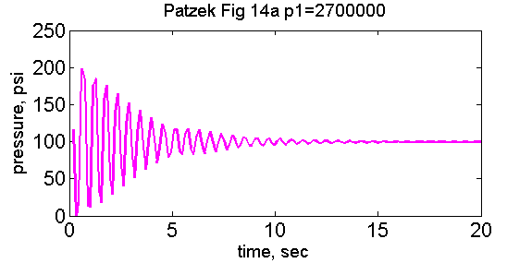
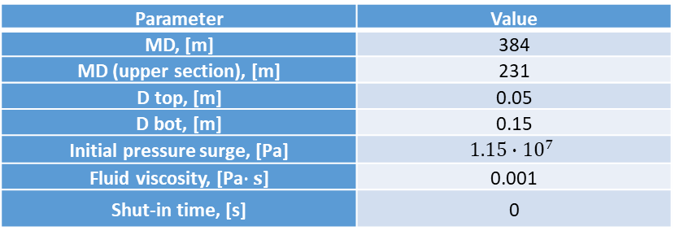
Vertical wellbore (Patzek&De, 2000)
T.W. Patzek, A. De Lossy Transmission Line Model of Hydrofractured Well Dynamics, 2000
Vertical wellbore with two sections and elongated perforation interval
Models used:
Injective model I-M
Parameter | Value
MD, [m] | 384
MD (upper section), [m] | 231
D top, [m] | 0.05
D bot, [m] | 0.15
Initial pressure surge, [Pa] | $$1.15∙{10}^{7}$$
Fluid viscosity, [Pa$∙s$] | 0.001
Shut-in time, [s] | 0

Slide 14
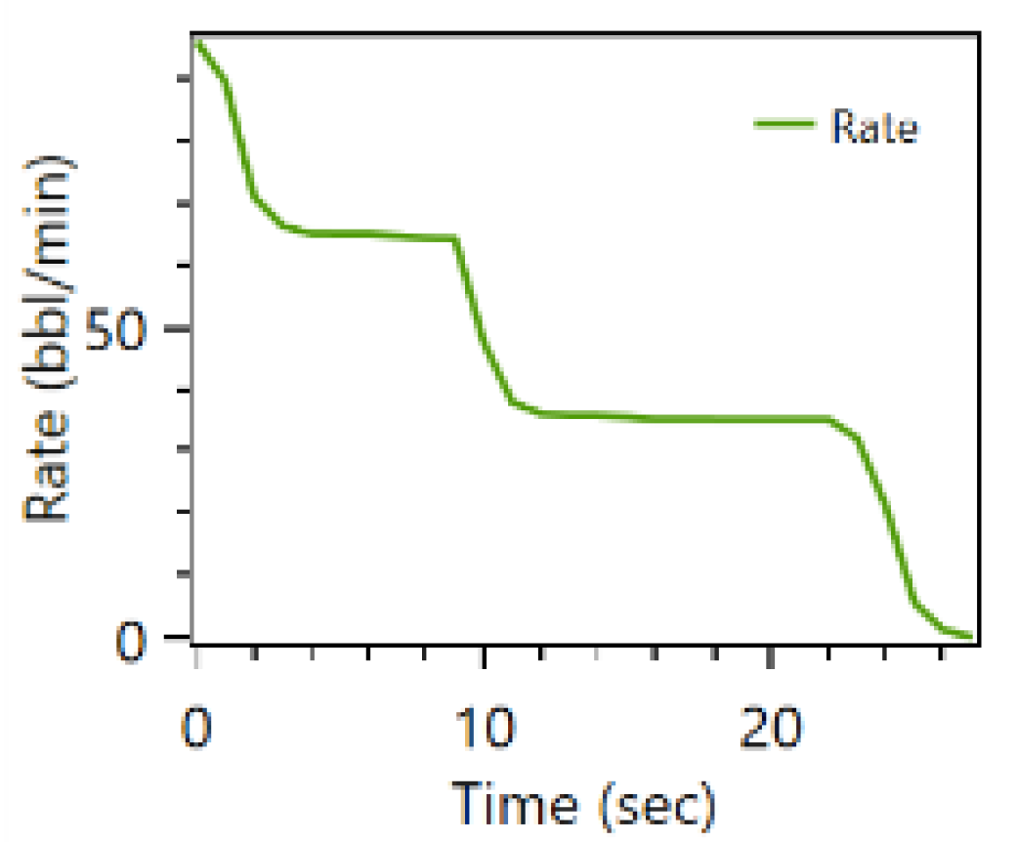
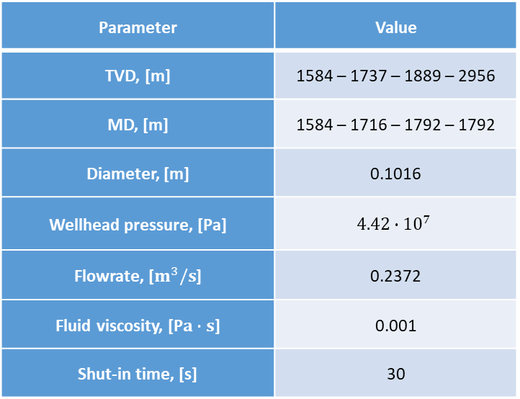
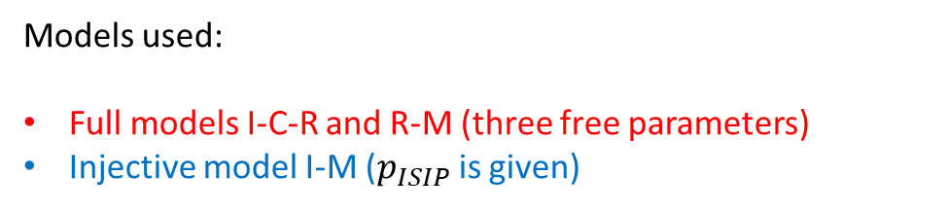
Horizontal wellbore (Hwang, 2017)
Hwang, J et al. Hydraulic Fracture Diagnostics and Stress Interference Analysis by Water Hammer Signature in Multi-Stage Pumping Data, 2017.
Water hammer after one of the stages on the horizontal wellbore was described.
Parameter | Value
TVD, [m] | 1584 – 1737 – 1889 – 2956
MD, [m] | 1584 – 1716 – 1792 – 1792
Diameter, [m] | 0.1016
Wellhead pressure, [Pa] | $$4.42∙{10}^{7}$$
Flowrate, [$m^{3}/s$] | 0.2372
Fluid viscosity, [P$a∙s$] | 0.001
Shut-in time, [s] | 30
Flowrate has decreased slowly during 30 s
Models used:
Full models I-C-R and R-M (three free parameters)
Injective model I-M ($p_{ISIP}$ is given)

Slide 15
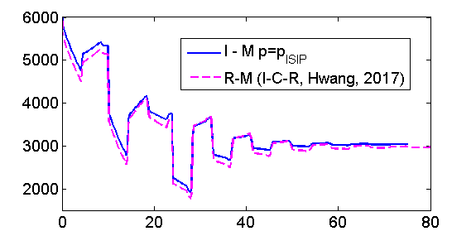
Horizontal wellbore (Hwang, 2017)
WH calculations using I-M model (blue) and using I-C-R model (dashed pink).
When I-C-R model is used calculated volume of the fracture for parameters proposed by Hwang is 800 $m^{3}$ (?).
Water hammer signature is the same after 3 order reduction capacitance coefficient C, i.e. V=0.8 $m^{3}$ (?!)

Slide 16
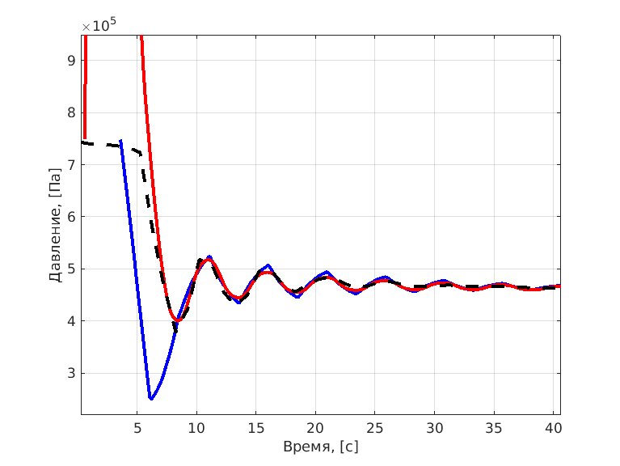
Influence of Non-Newtonian properties
We also consider wellbore filled with non-Newtonian fluid (linear gel).
Friction losses can be estimated using:
Power-law fluid correlations for friction
Two-viscosity model
Both methods are in error to predict initial pressure surge. This is due to the fact that such methods apply only for quasi-steady cases.
Pulsations in non-Newtonian fluid have been studied recently in papers Duarte, 2008 and Hullender, 2018, but for the Water Hammer problem further investigations are needed.
Pressure after shut-in, wellbore filled with linear gel. Dashed line ─ experimental data, red line ─ two-viscosity model, blue line ─ power-law fluid correlations

Slide 17
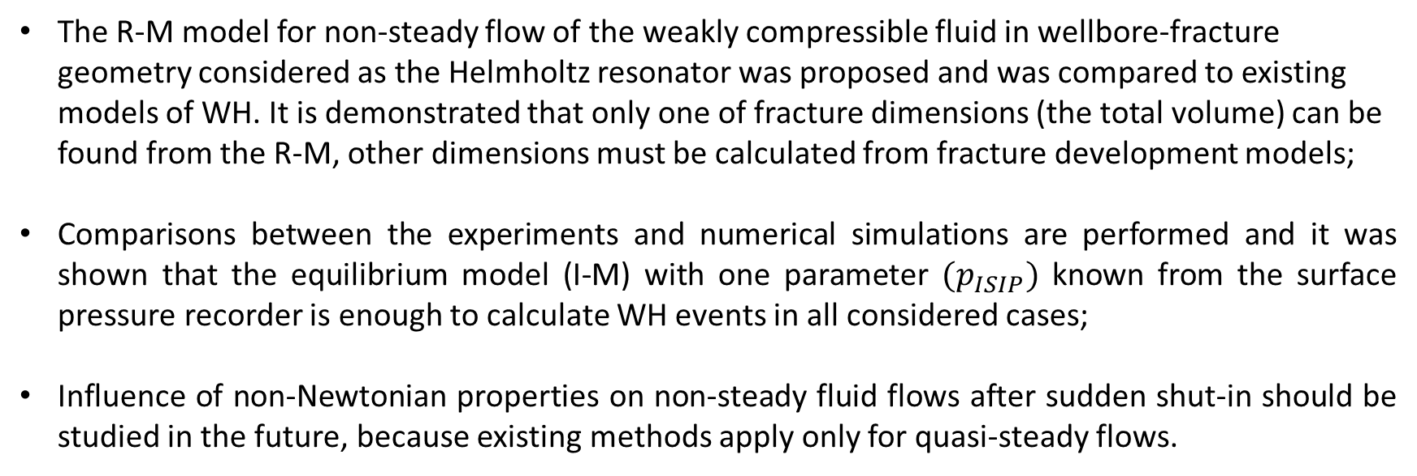
Conclusions
The R-M model for non-steady flow of the weakly compressible fluid in wellbore-fracture geometry considered as the Helmholtz resonator was proposed and was compared to existing models of WH. It is demonstrated that only one of fracture dimensions (the total volume) can be found from the R-M, other dimensions must be calculated from fracture development models;
Comparisons between the experiments and numerical simulations are performed and it was shown that the equilibrium model (I-M) with one parameter ${(p}_{ISIP})$ known from the surface pressure recorder is enough to calculate WH events in all considered cases;
Influence of non-Newtonian properties on non-steady fluid flows after sudden shut-in should be studied in the future, because existing methods apply only for quasi-steady flows.

